Slide 1
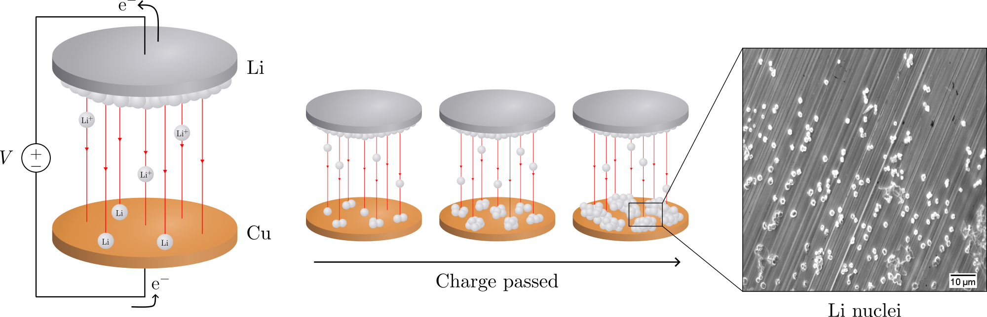
Electrochemical deposition of lithium on copper
Gottfrid Olsson
2024-05-29

Slide 2
PLAN: 25 minute presentation
Introduction:
Importance of batteries, improvements LMB>LIB (fig.), problems non-uniform growth (fig + in-depth), purpose of this thesis
Theory:
Homogenous nucleation theory; main results (fig.), how does eta impact r and N (fig.)?
Methods:
Cell assemblies (note importances; wave spring, no pressure); cycling protocol (fig.)
Results:
passivation of Cu; J-dep.; pressure (C-cell and T-cell, r & angle dep. and morphology)
Conclusion: 2 min
Passivation, J-dep. and pressure to achieve uniform deposition in LMBs
(Opposition and Questions from audience)

Slide 3
Introduction
Batteries
Lithium-ion battery very common type; you probably have it!
Lighter and smaller by replacing graphite in LIB with Li-metal

Slide 4
Batteries!
Opening: How many here have either a smartphone, a laptop, or a smartwatch?
Cool, then you are already fans of batteries, and you likely own at least one lithium-ion battery – a very common battery type
Say, would you like your device to be smaller, lighter, and have a longer battery life? Of course you would!
It’s easy, look: replace this graphite with Li and the cell increases its energy per weight and doubles the energy per volume – very nice!
Let’s use this battery. Oh… what’s happening? Without the graphite, Li gets deposited on the surface. The Li grows unevenly, and oh no – look – it reached the other side of the cell! It’s a short-circuit, and [thermal runaway] *BOOM* [cell explosion]
Yikes. Not good. Uneven deposition seems to be a problem.
There are in fact several problems.

Slide 5
Batteries!
250 Wh kg^{–1} to 440 Wh kg^{–1}
600 Wh L^{–1} to 1200 Wh L^{–1}
//LIB one of the most used batteries today
Looks like this.
If replace graphite with Li, increase specific energy and double the energy density
Would benefit e.g. electrical vehicles (extra range)
However, problems bcs. Li depos on surface! (n.s.)

Slide 6
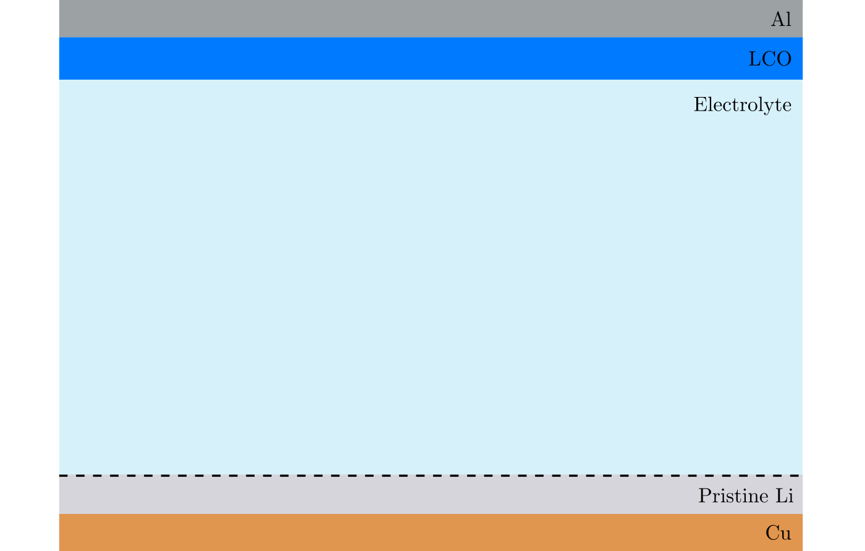
Non-uniform deposition problems

Slide 7
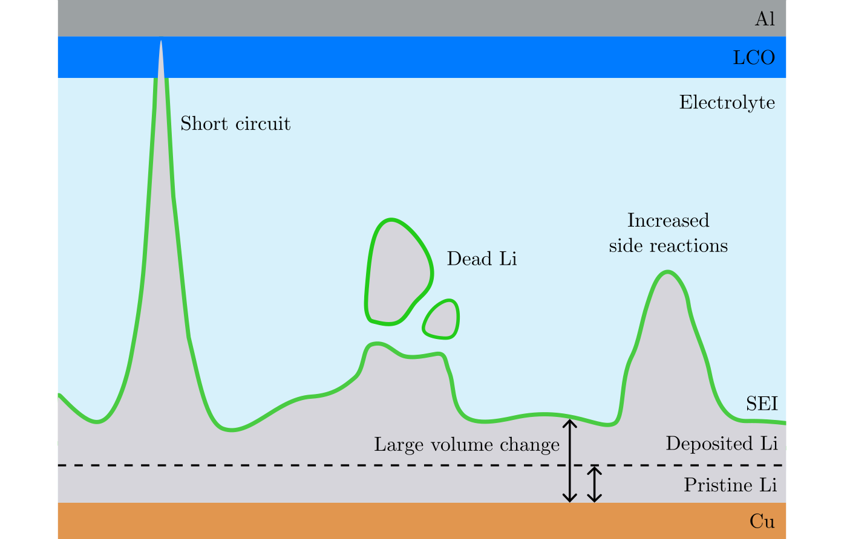
Non-uniform deposition problems

Slide 8
Purpose of this thesis
To avoid non-uniform deposition, the first step in deposition of Li – nucleation, must be well understood.
Purpose: investigate how pressure, current, and passivation influences the nucleation.
Scanning electron microscopy (SEM) and electrochemical cycling.

Slide 9
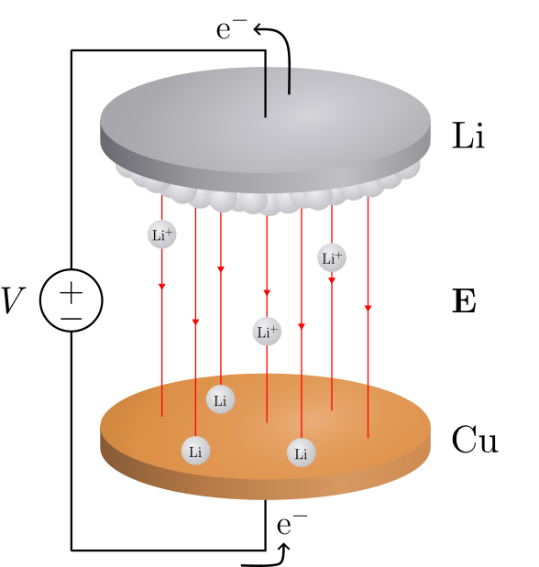
Deposition in a Li/Cu cell

Slide 10
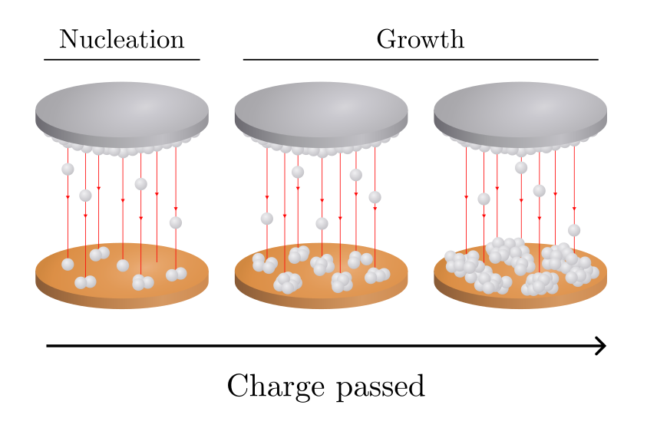
Deposition in a Li/Cu cell

Slide 11
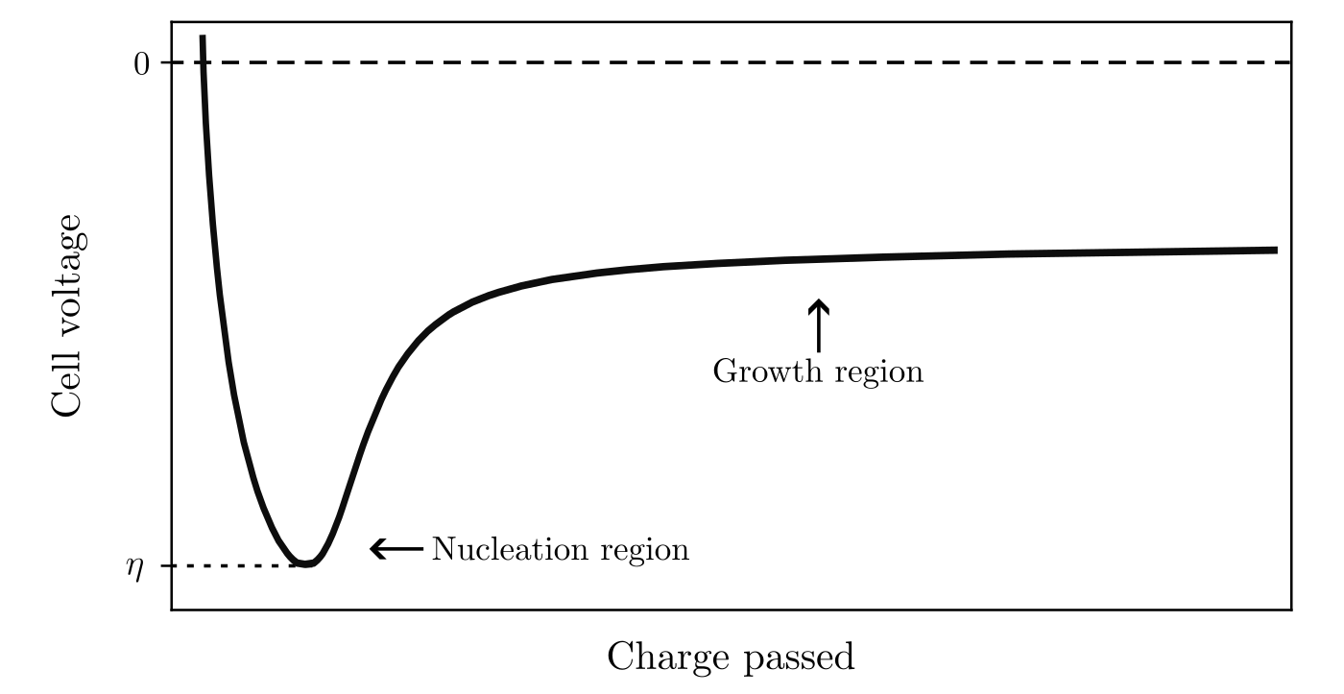
Deposition in a Li/Cu cell

Slide 12
Deposition in a Li/Cu cell

Slide 13
Deposition in a Li/Cu cell

Slide 14
Deposition in a Li/Cu cell

Slide 15
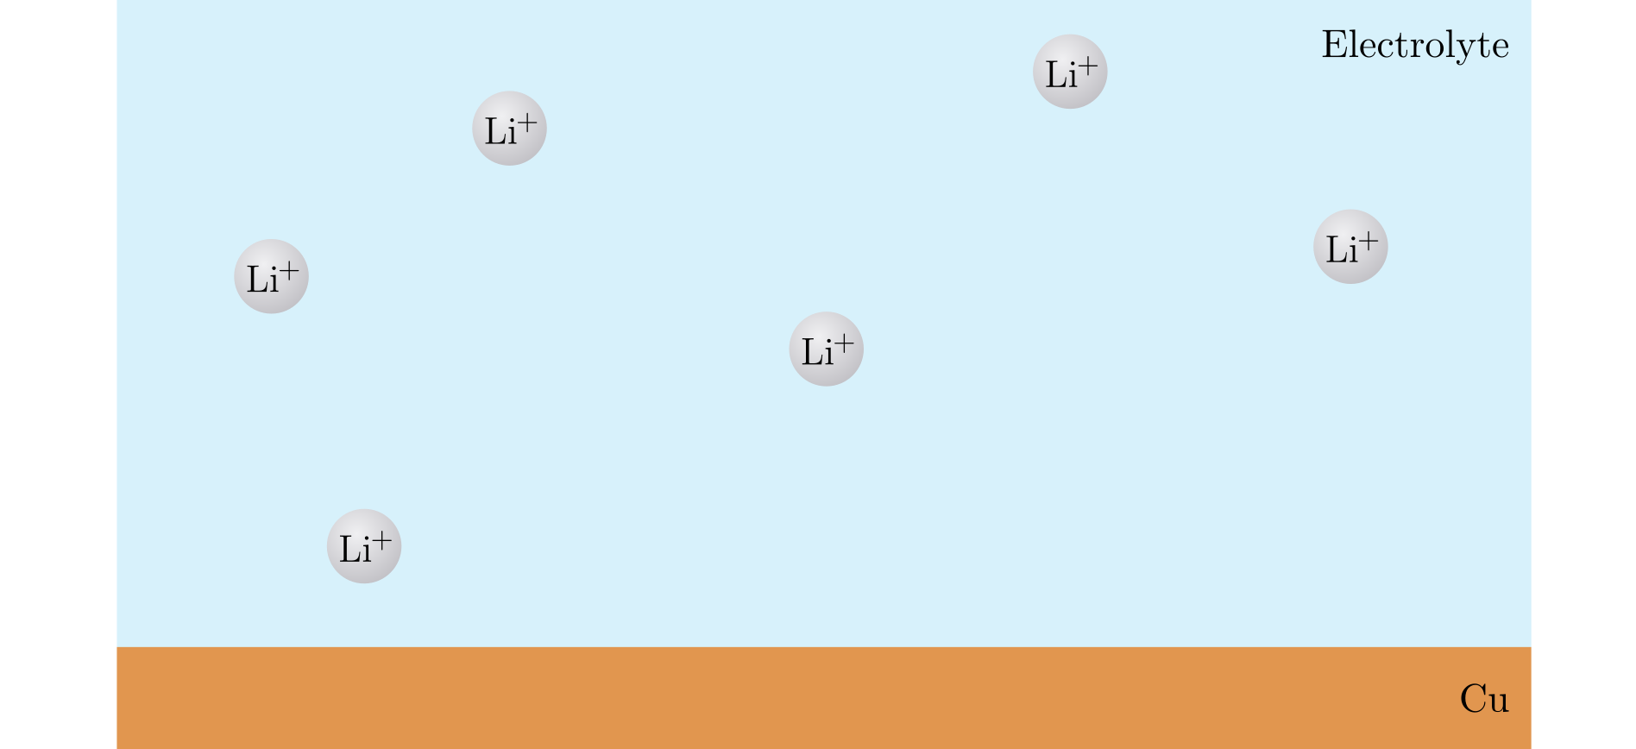
Nucleation
Notes:
Li-ions in solution (liquid) → Li-metal (solid)

Slide 16
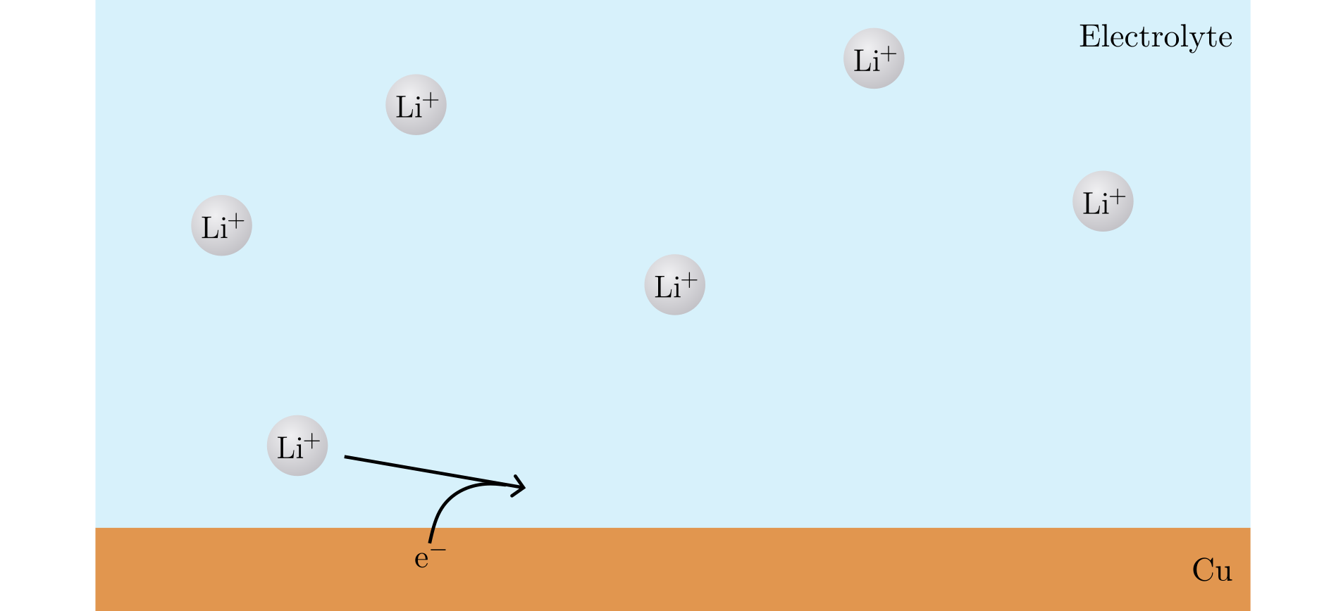
Nucleation

Slide 17
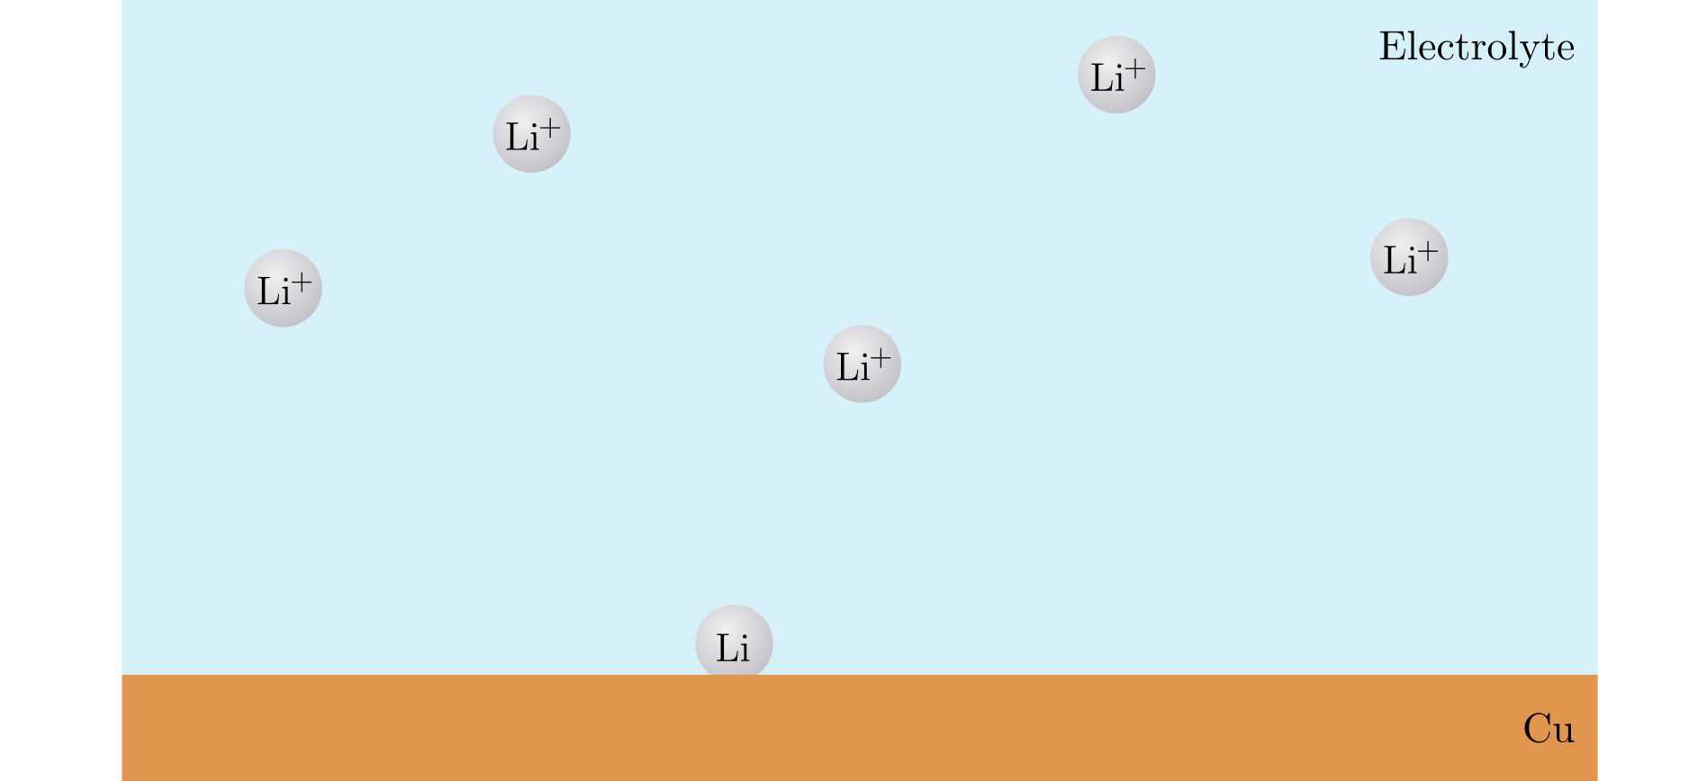
Nucleation

Slide 18
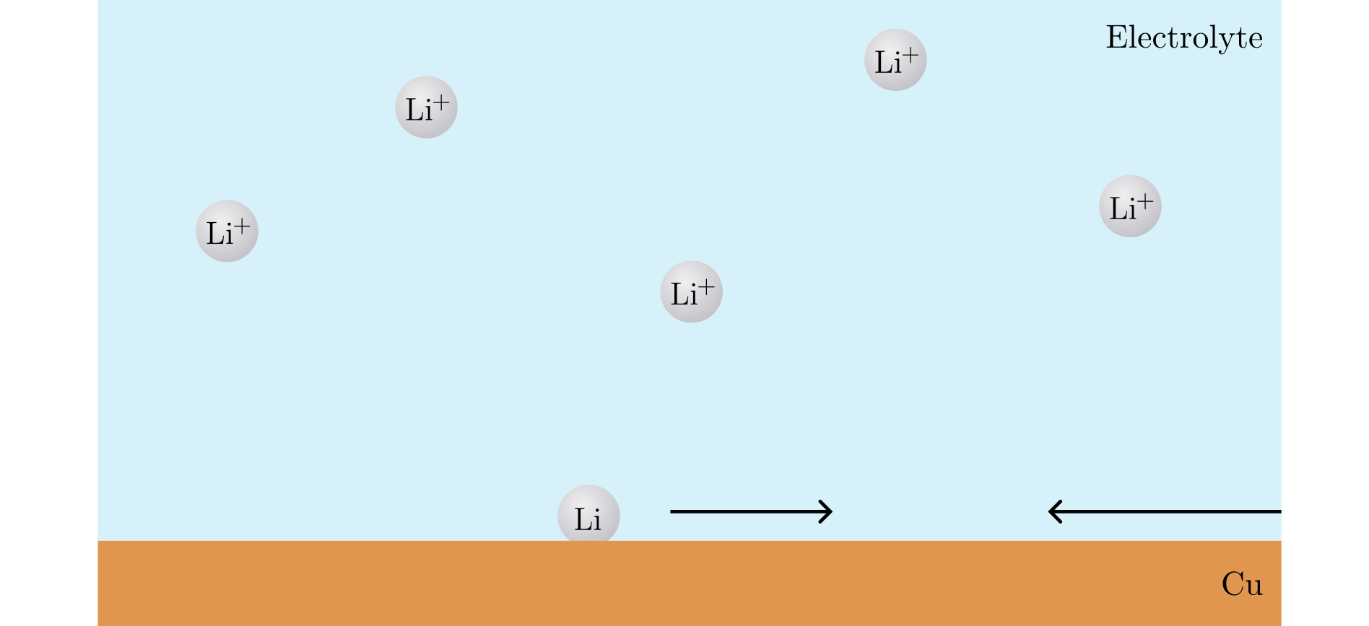
Nucleation

Slide 19
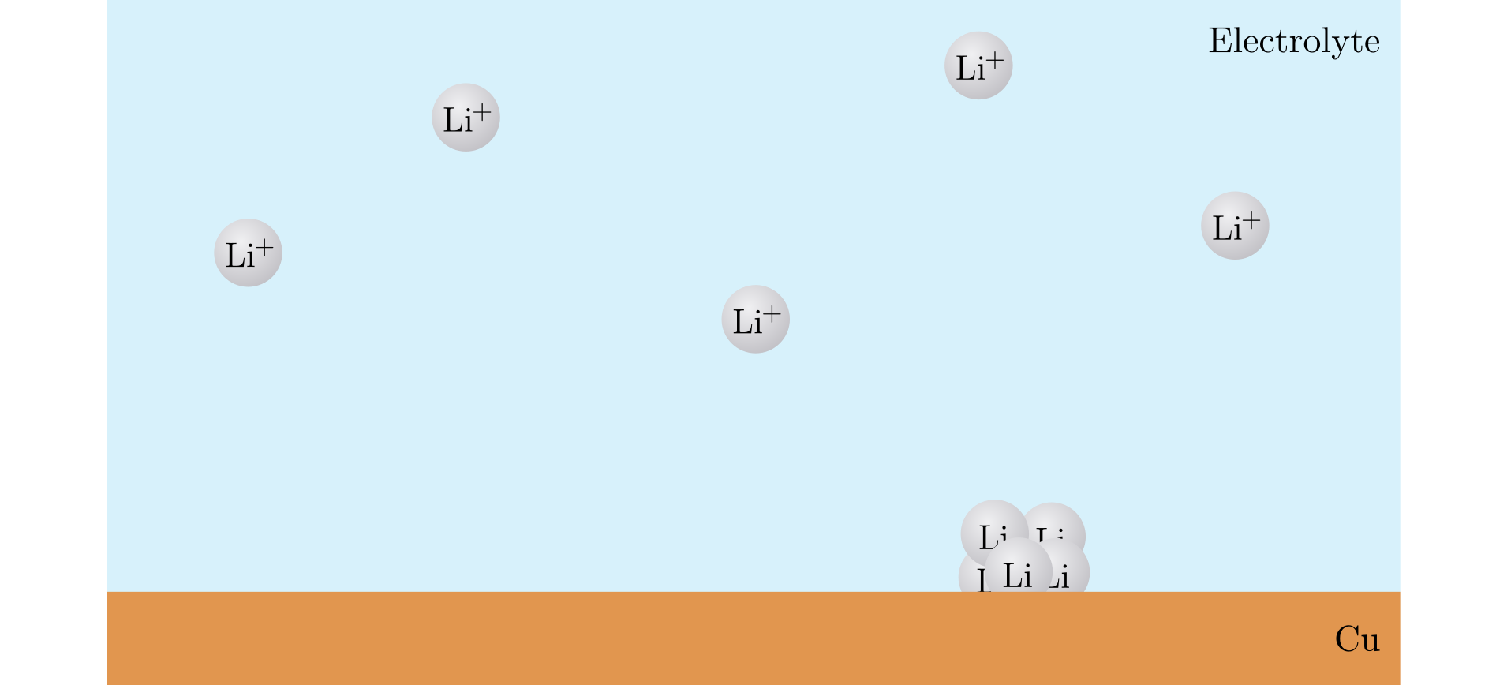
Nucleation

Slide 20
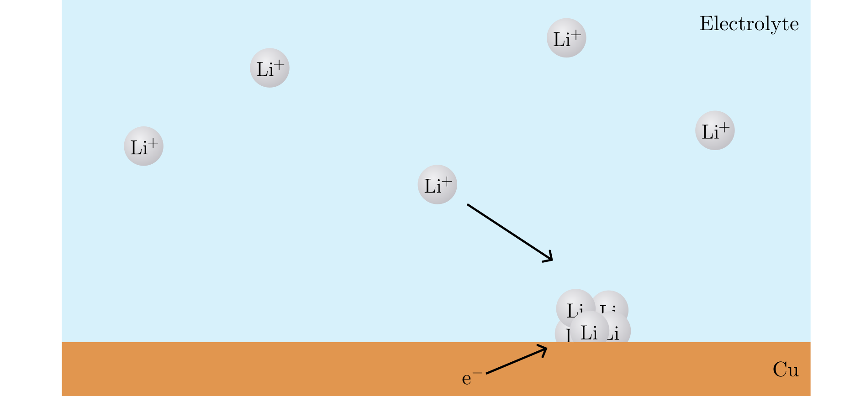
Nucleation

Slide 21
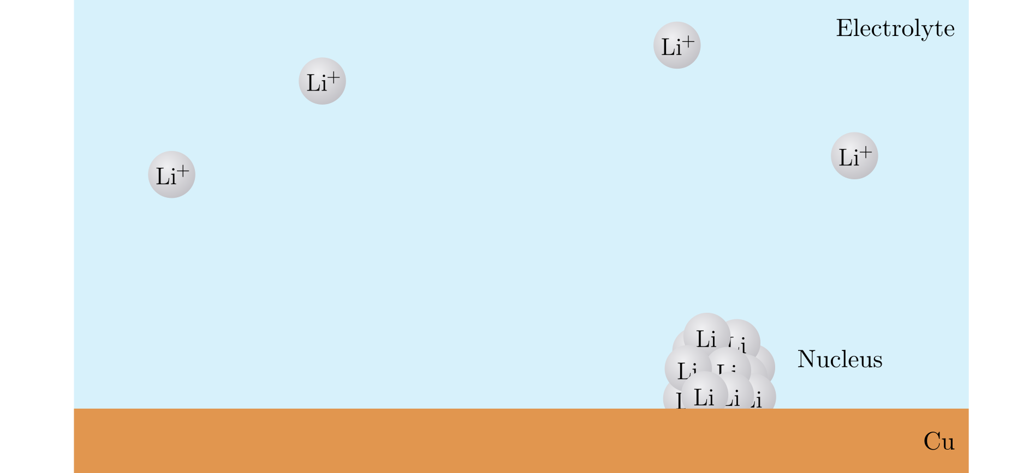
Nucleation

Slide 22
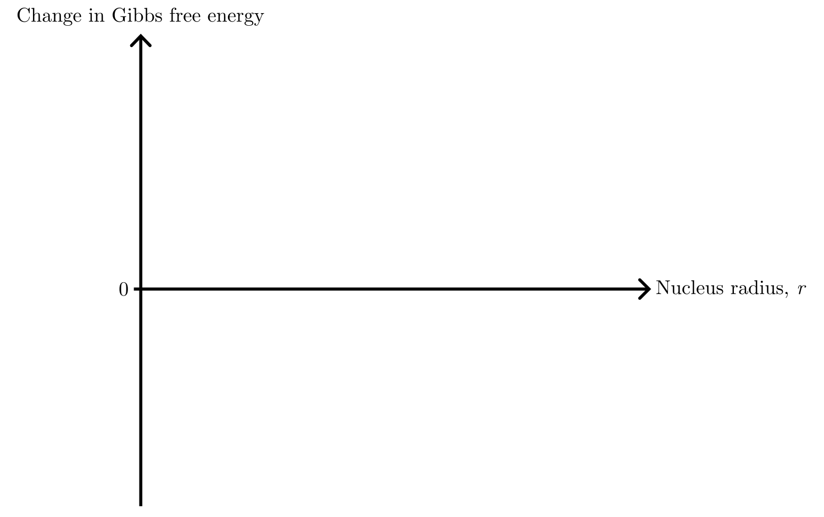
Nucleation theory

Slide 23
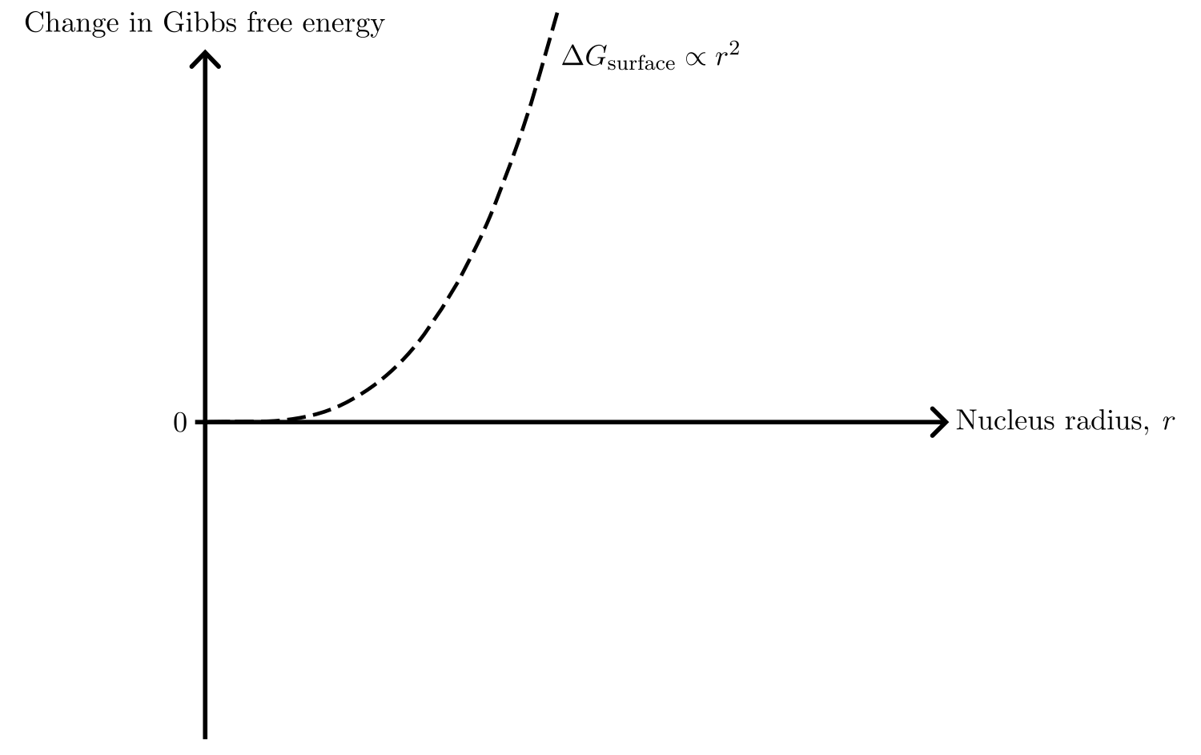
Nucleation theory

Slide 24
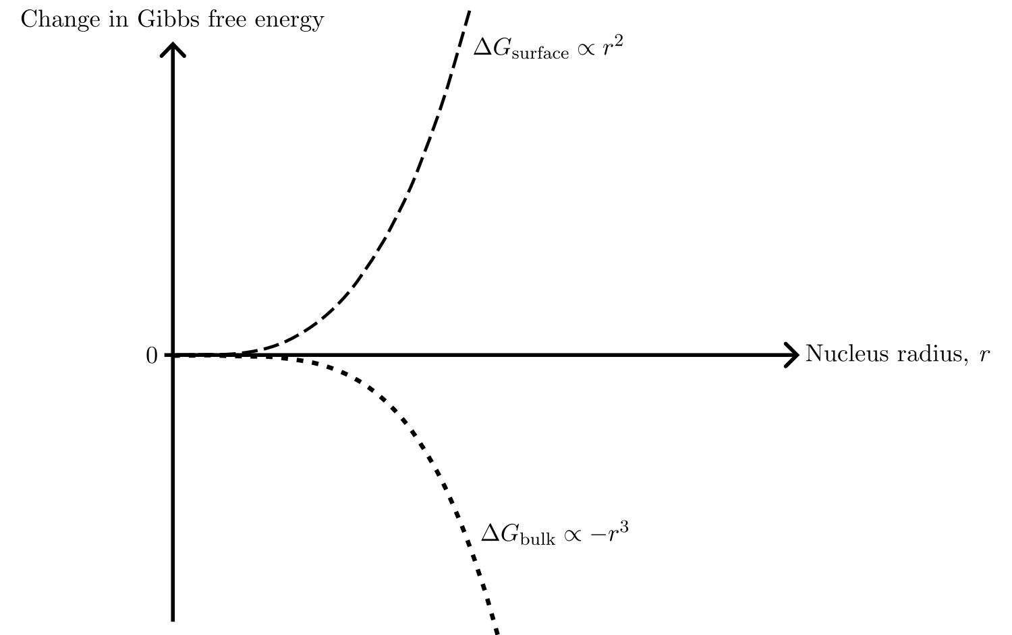
Nucleation theory

Slide 25
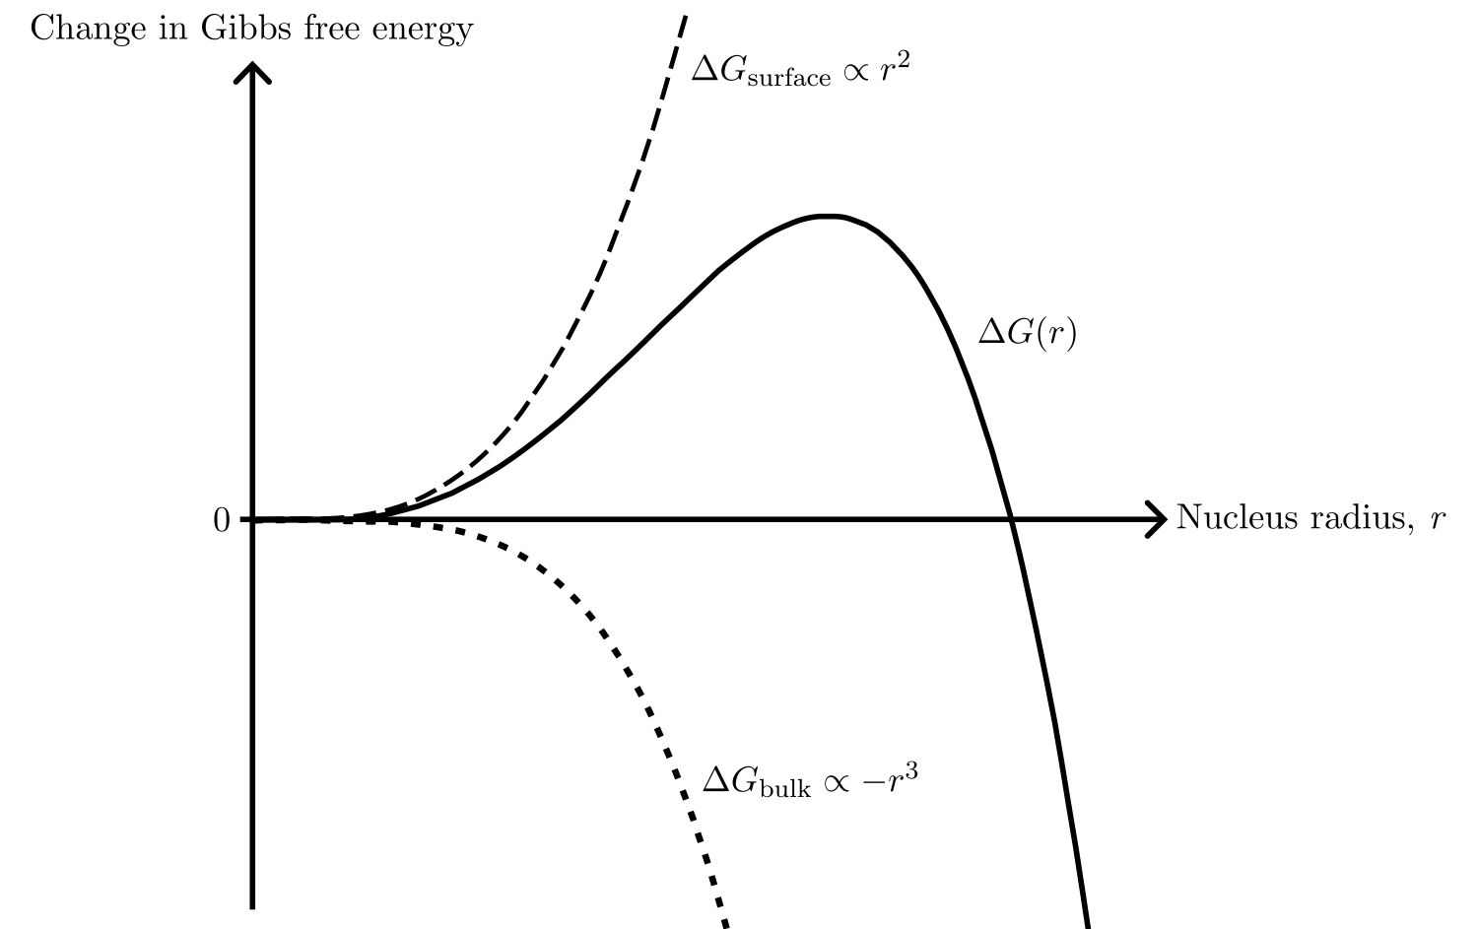
Nucleation theory

Slide 26
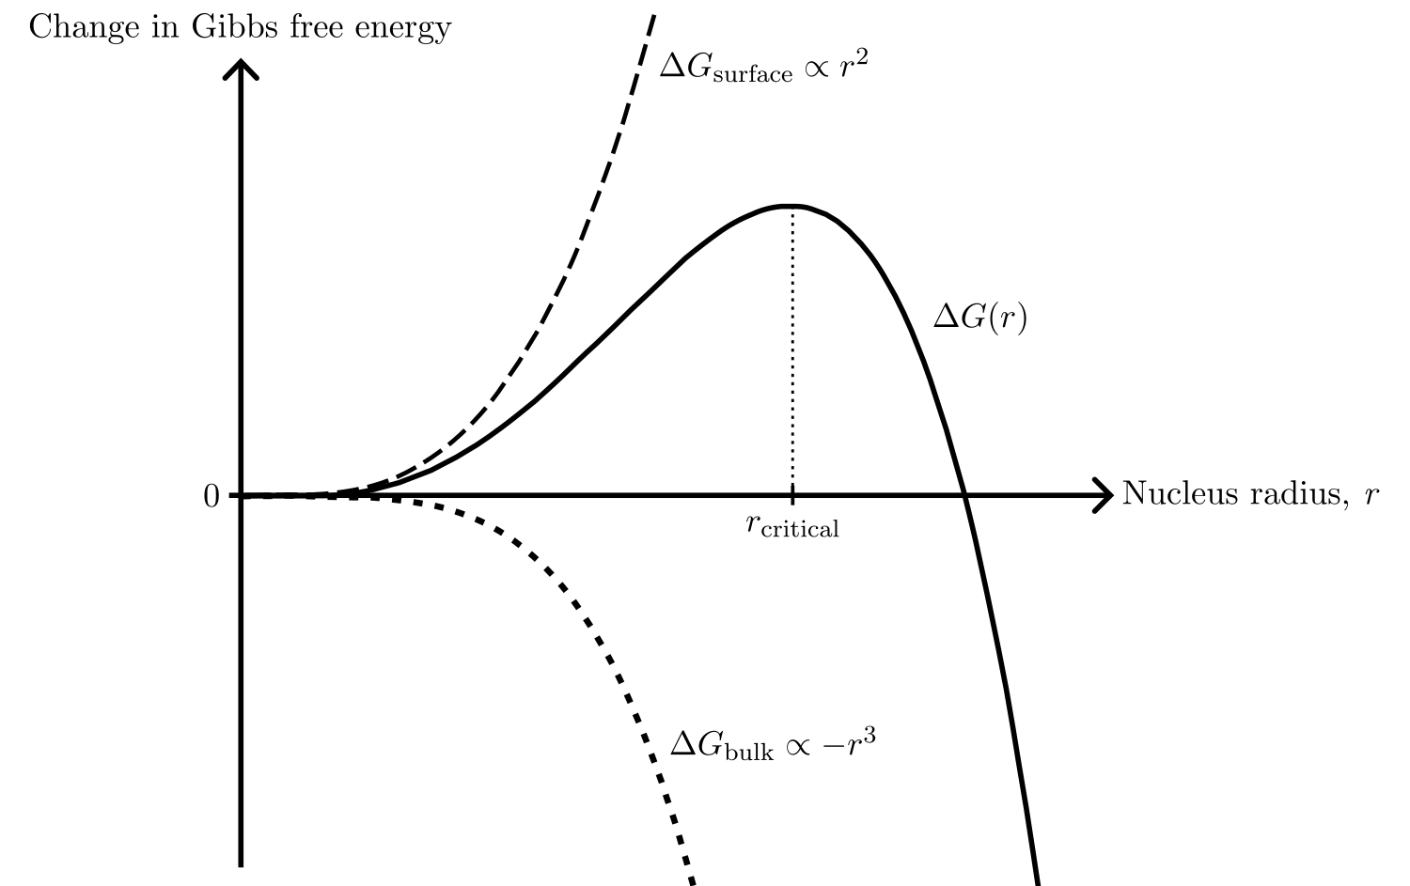
Nucleation theory

Slide 27
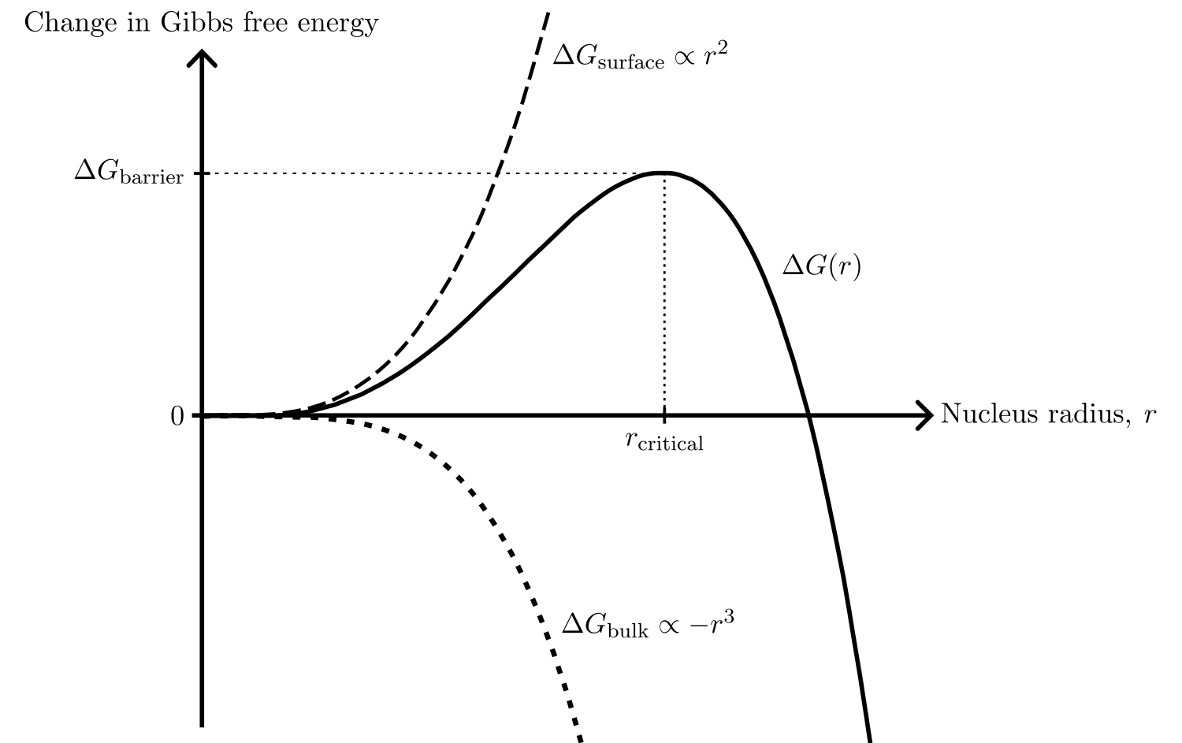
Nucleation theory

Slide 28
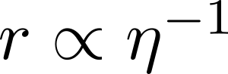
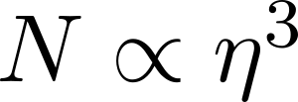
Nucleation theory

Slide 29
Nucleation theory

Slide 30
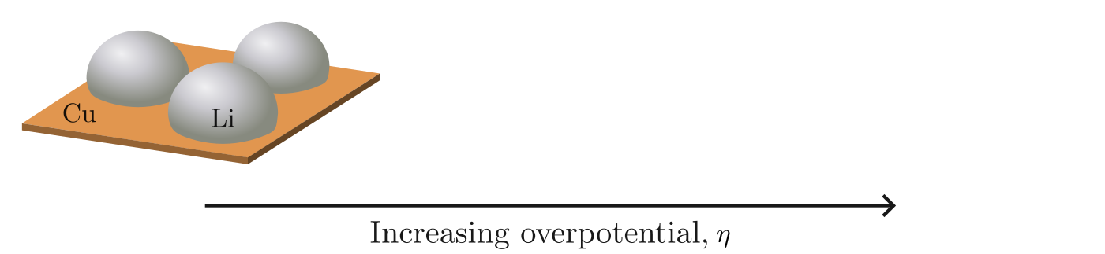
Nucleation theory

Slide 31
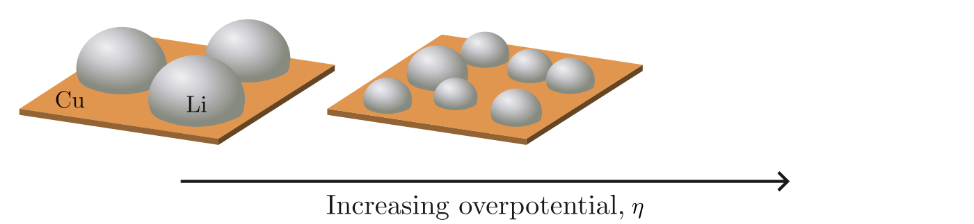
Nucleation theory

Slide 32
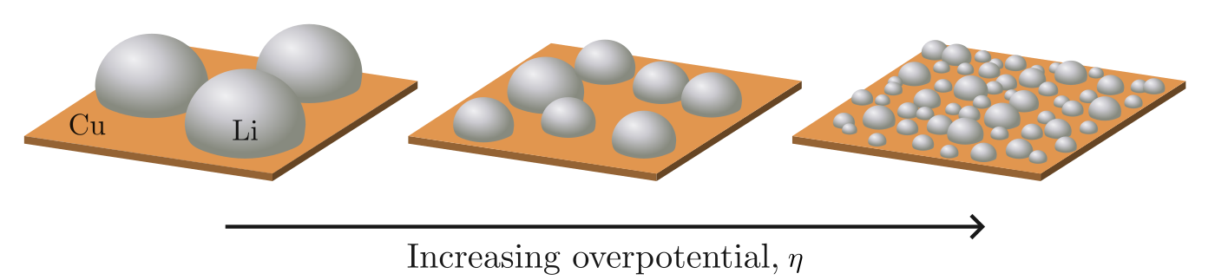
Nucleation theory

Slide 33
Specific scientific questions
The shape of the deposition curve
Degree of passivation of the Cu surface
Deposition current
Size and distribution of the nuclei
Pressure distribution between the Li and Cu
Notes:
For different pressure, we need two different cell setups

Slide 34
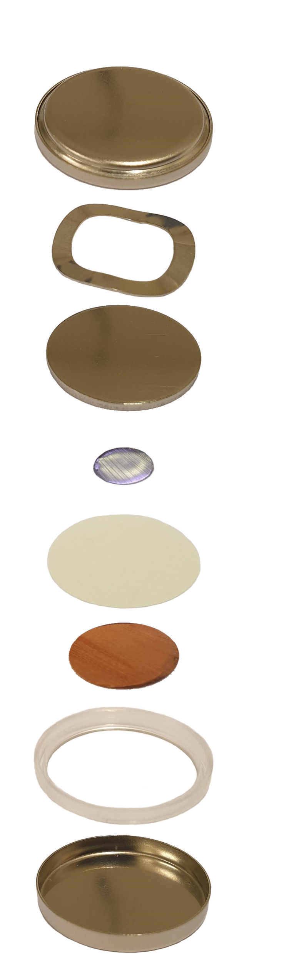
The C-cell
Cap
Spring
Spacer
Li
Separator
Cu
Gasket
Can

Slide 35
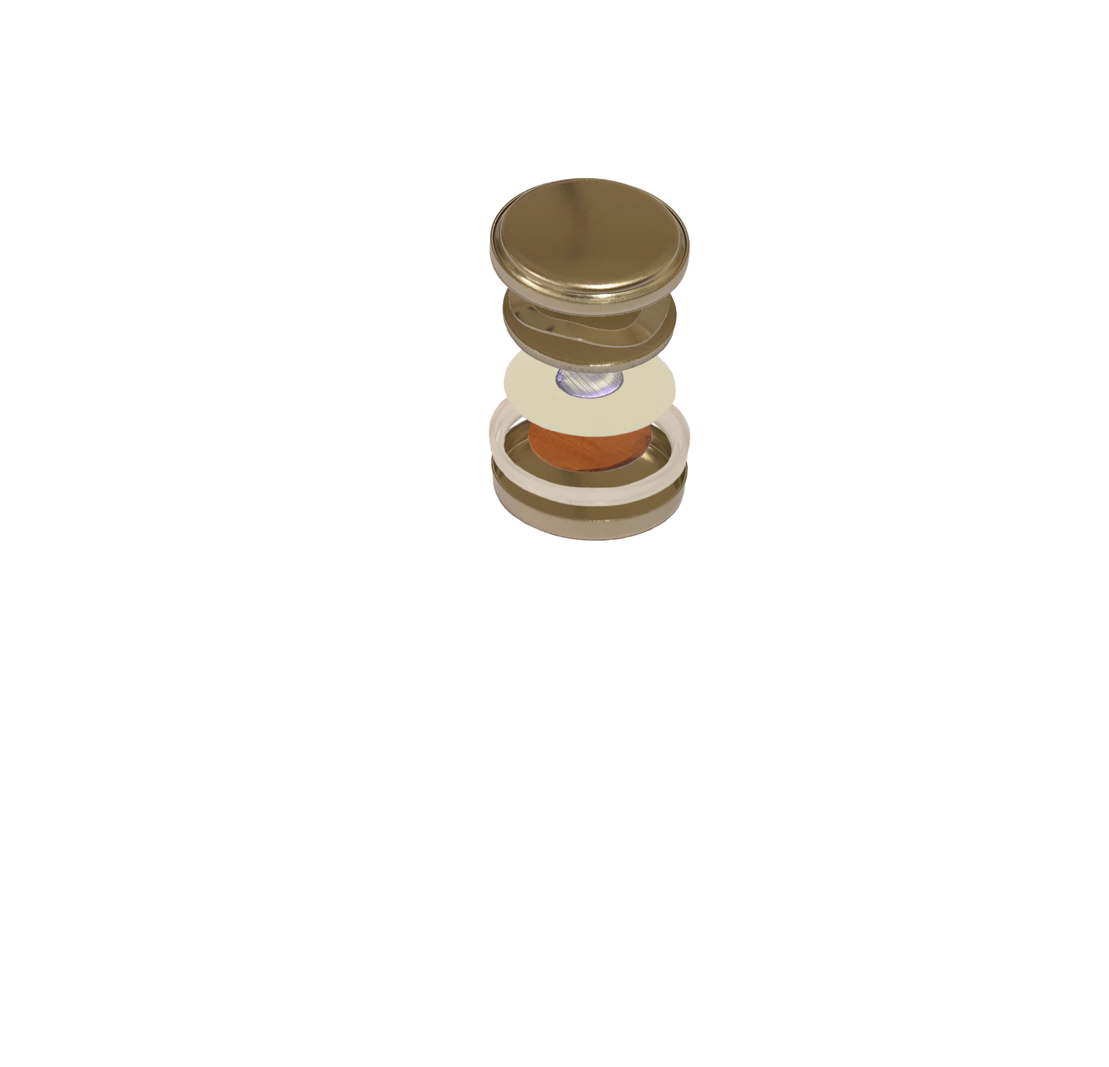
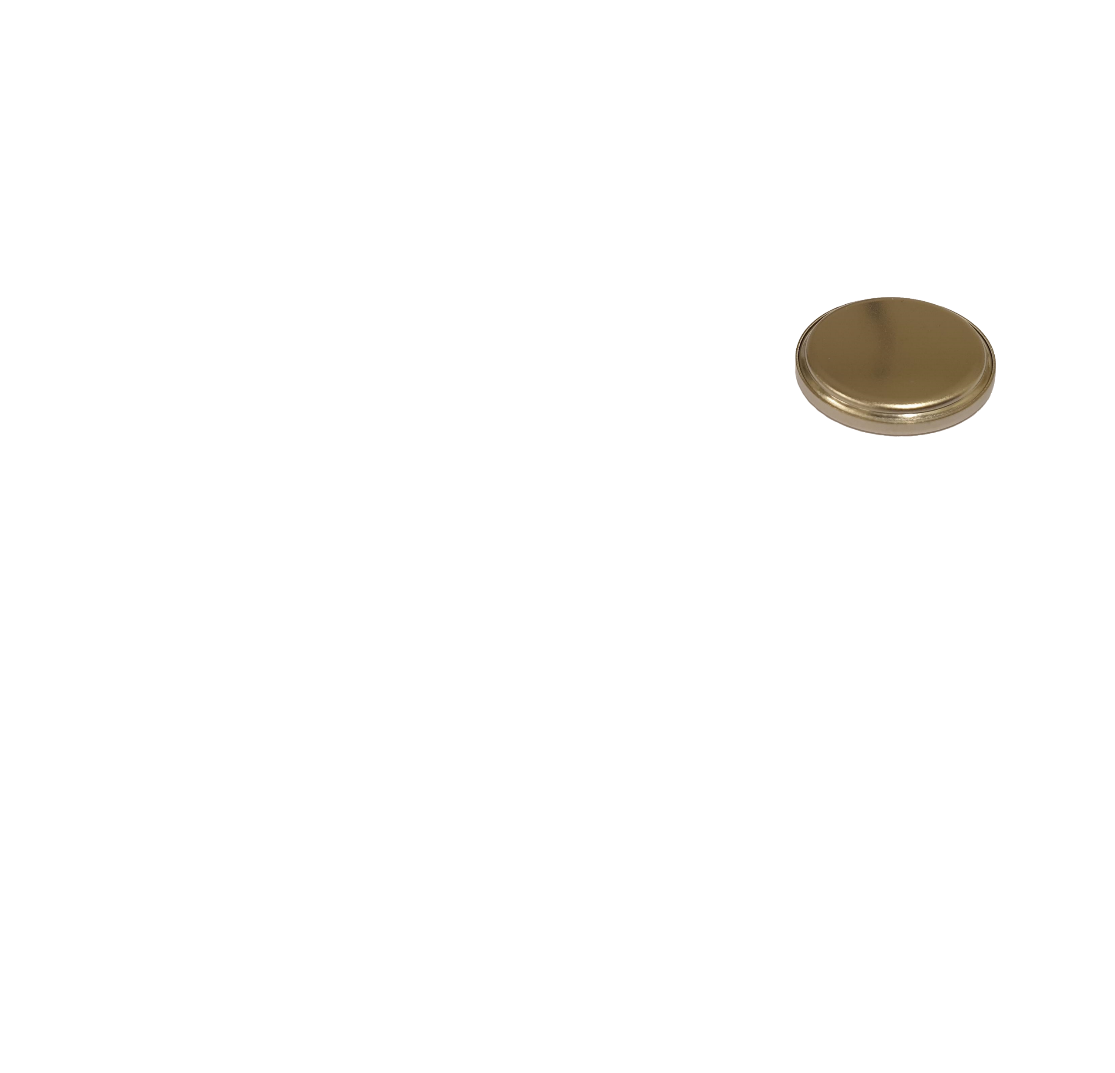
The C-cell
Cap
Spring
Spacer
Li
Separator
Cu
Gasket
Can

Slide 36
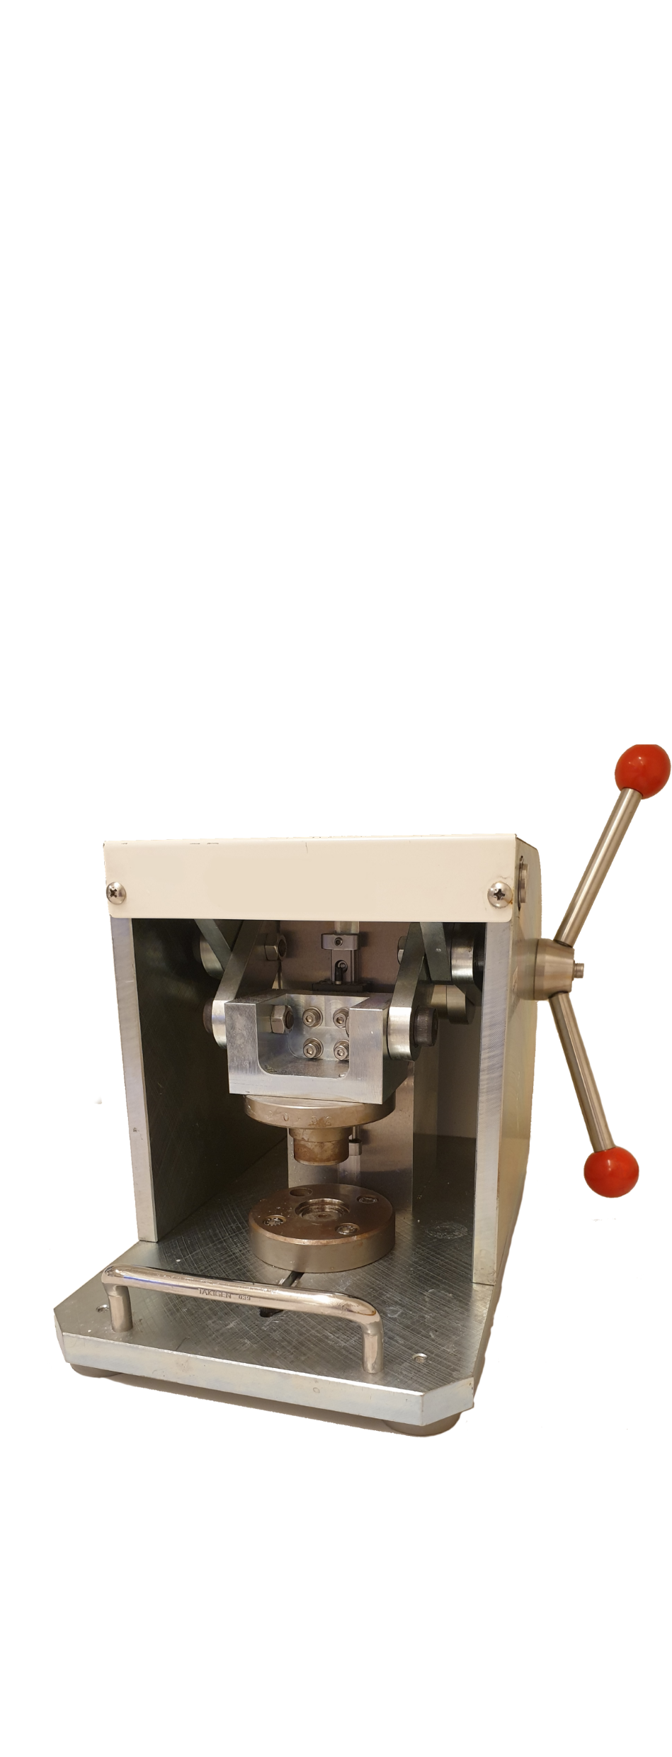
The C-cell
Cap
Spring
Spacer
Li
Separator
Cu
Gasket
Can

Slide 37

The C-cell
Cap
Spring
Spacer
Li
Separator
Cu
Gasket
Can

Slide 38
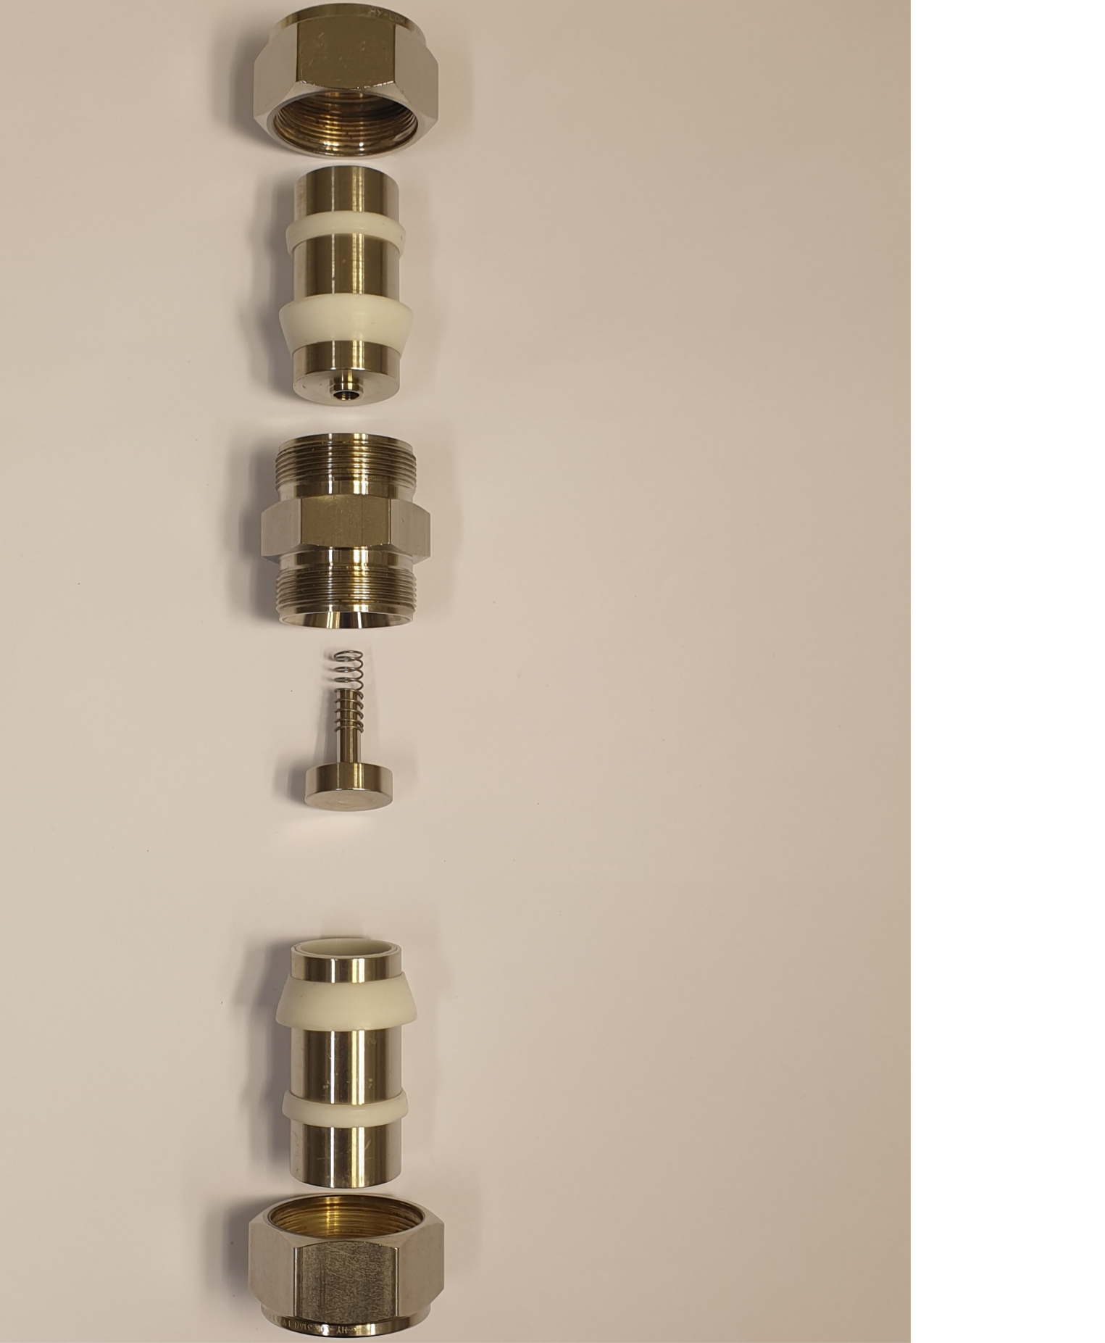
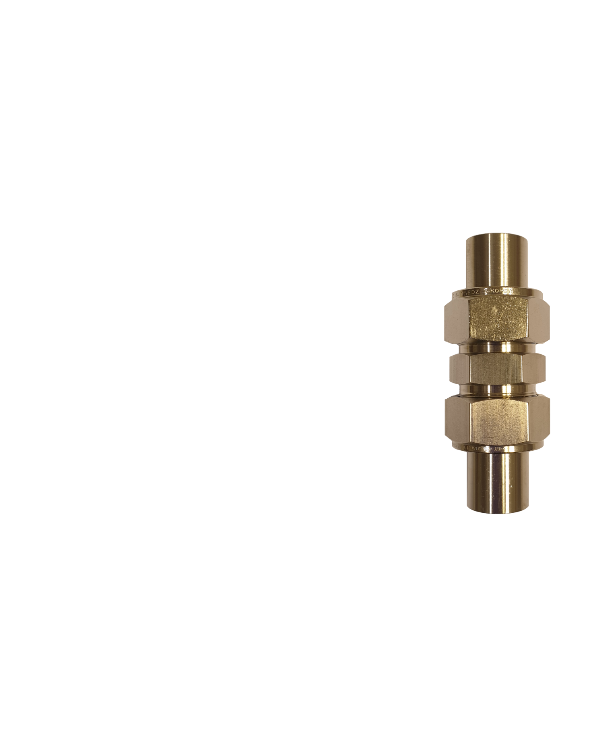

The I-cell
Nut
Metal rod
Sealing
rings
Main body
Spring
Spacer
Li
Separator
Cu

Slide 39
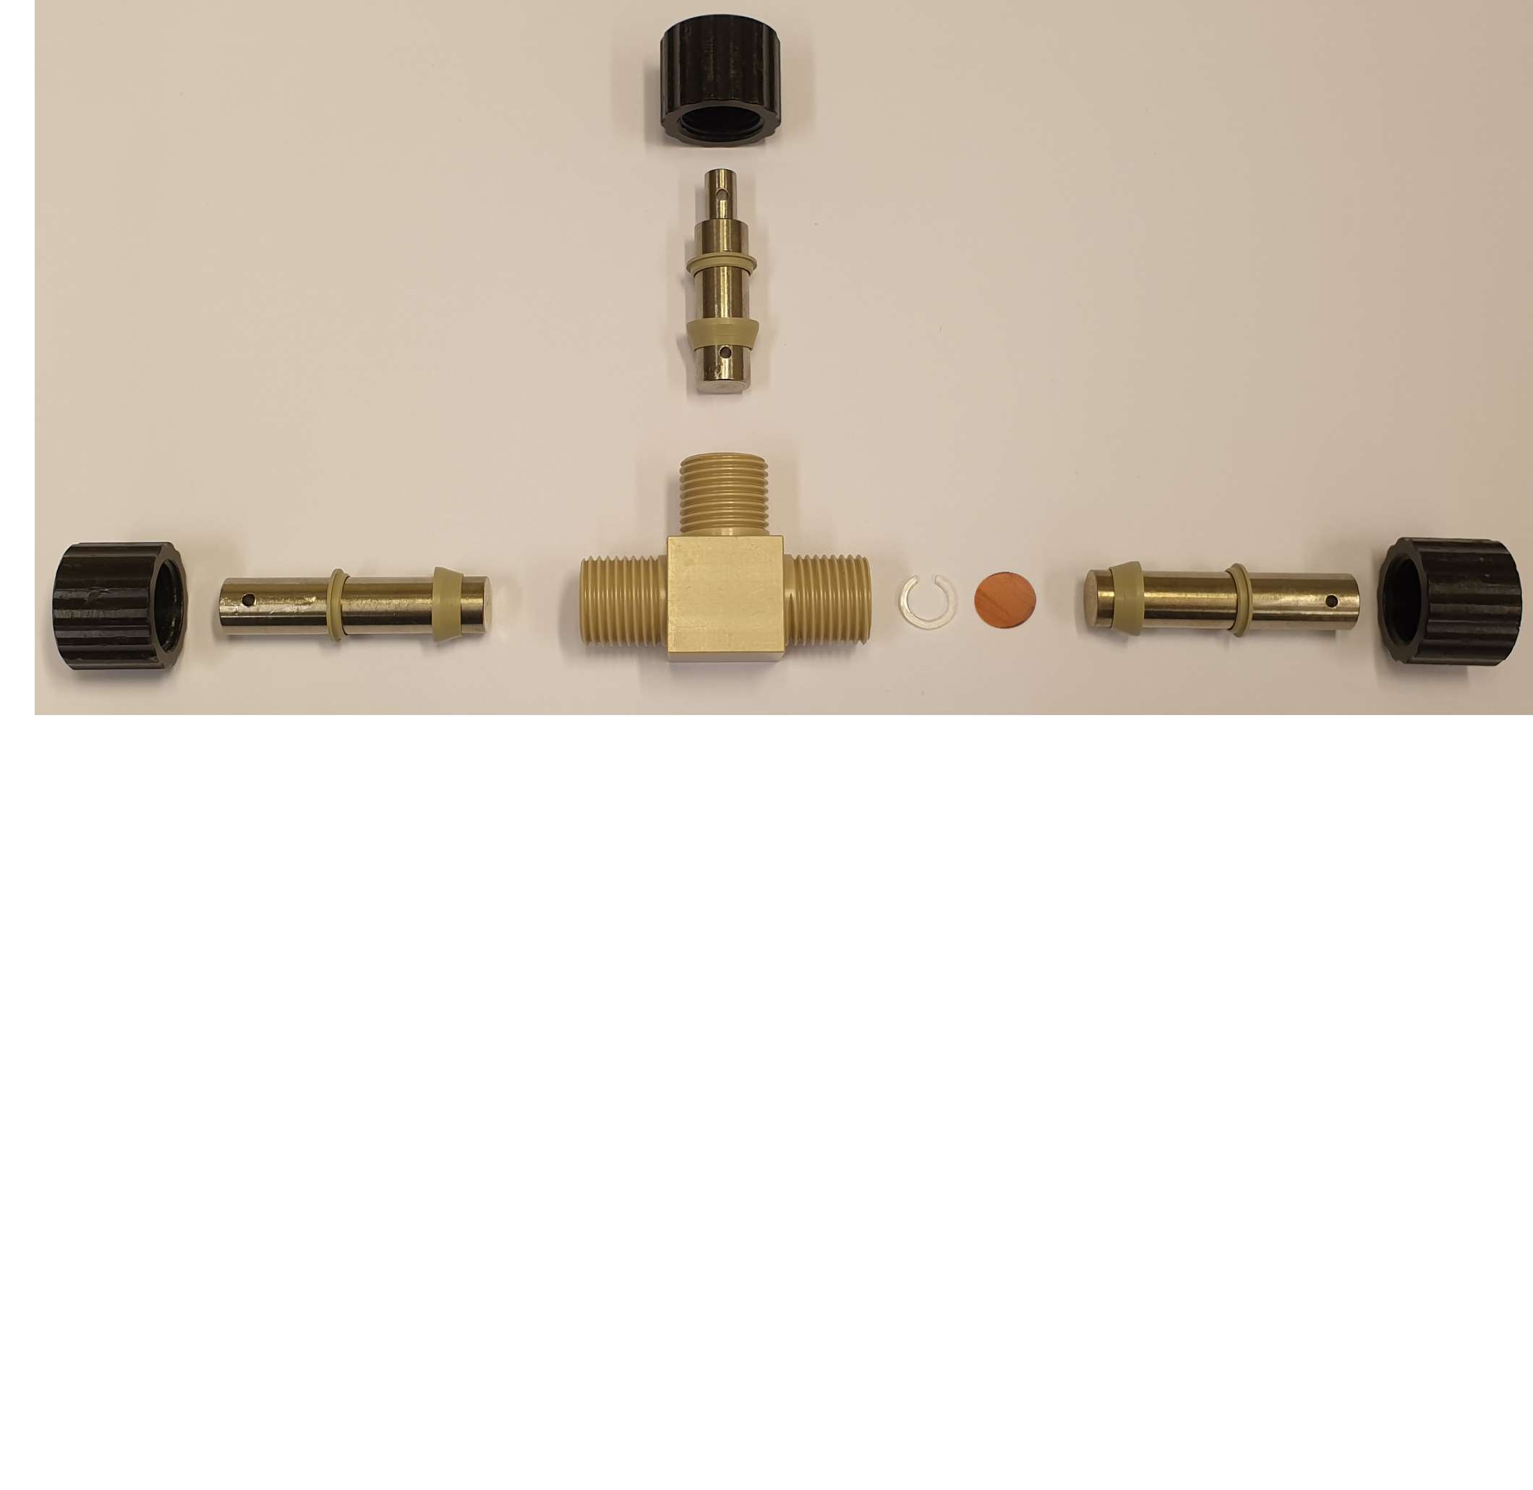

The T-cell
Nut
Metal rod
Sealing rings
Li
Main body
Spacer
Cu

Slide 40
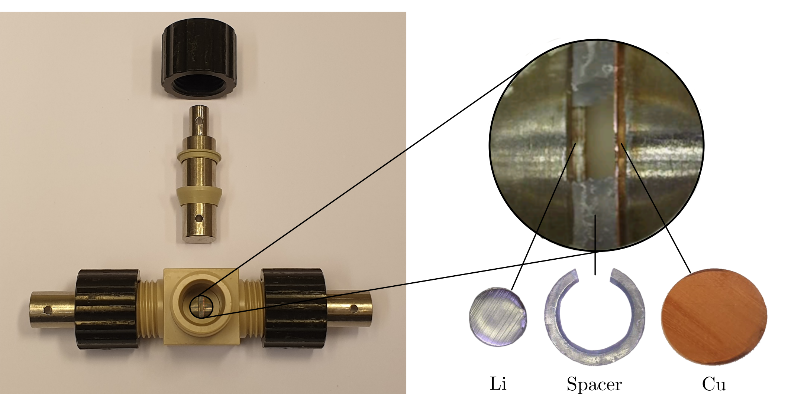
The T-cell

Slide 41
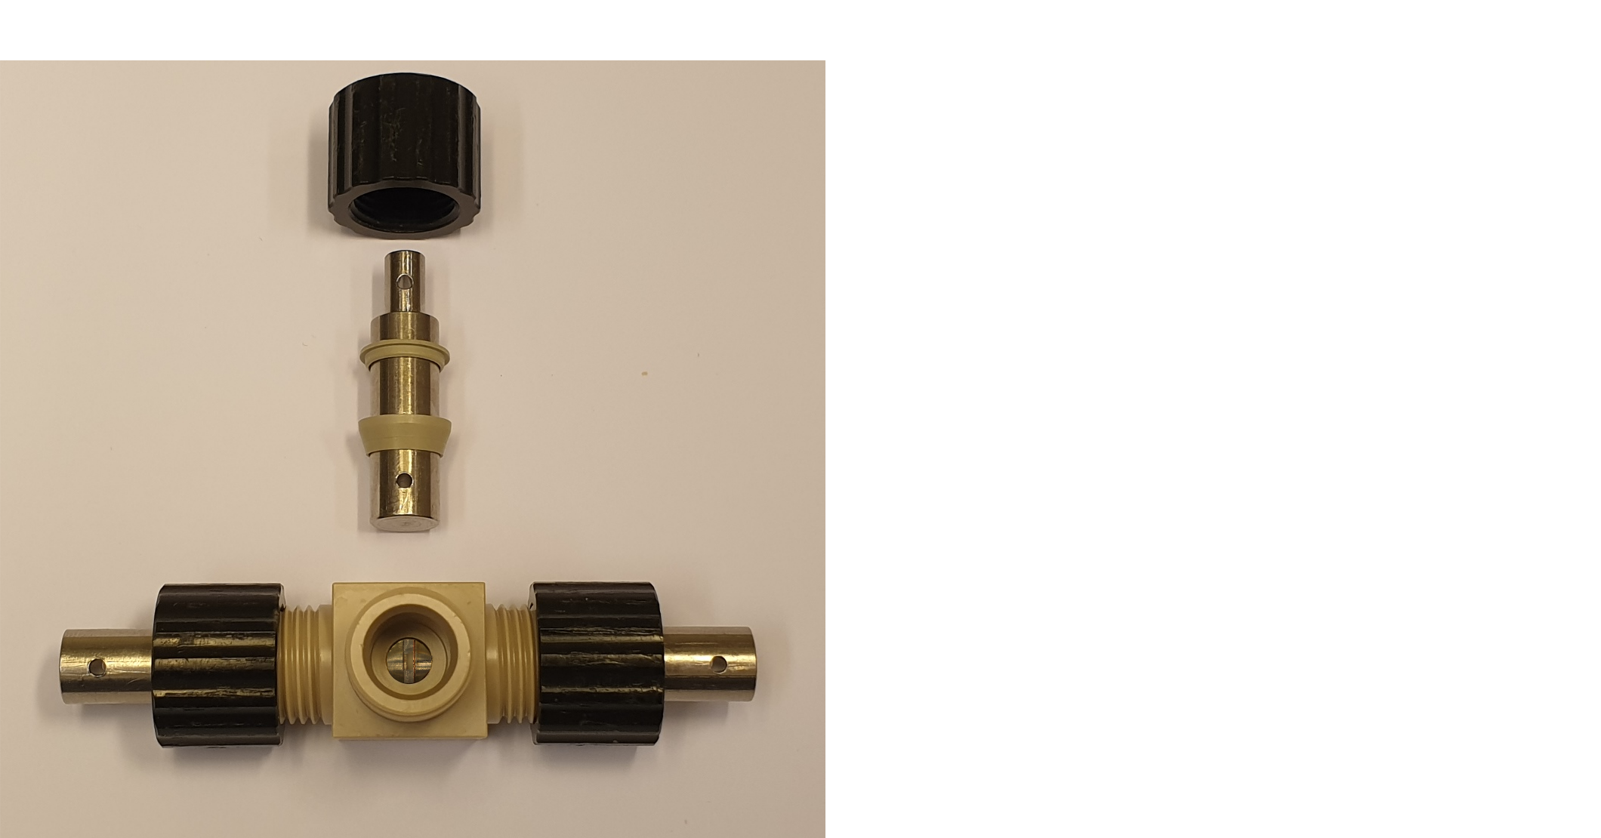
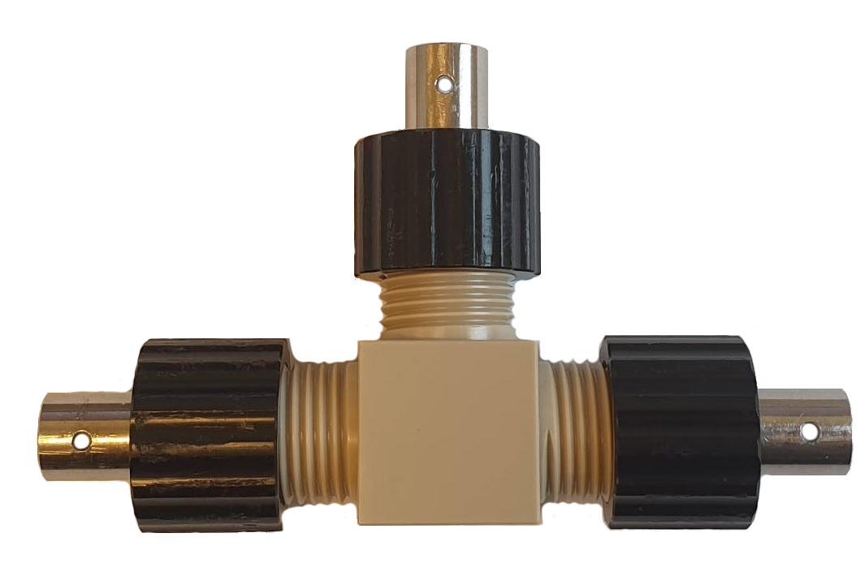
The T-cell

Slide 42
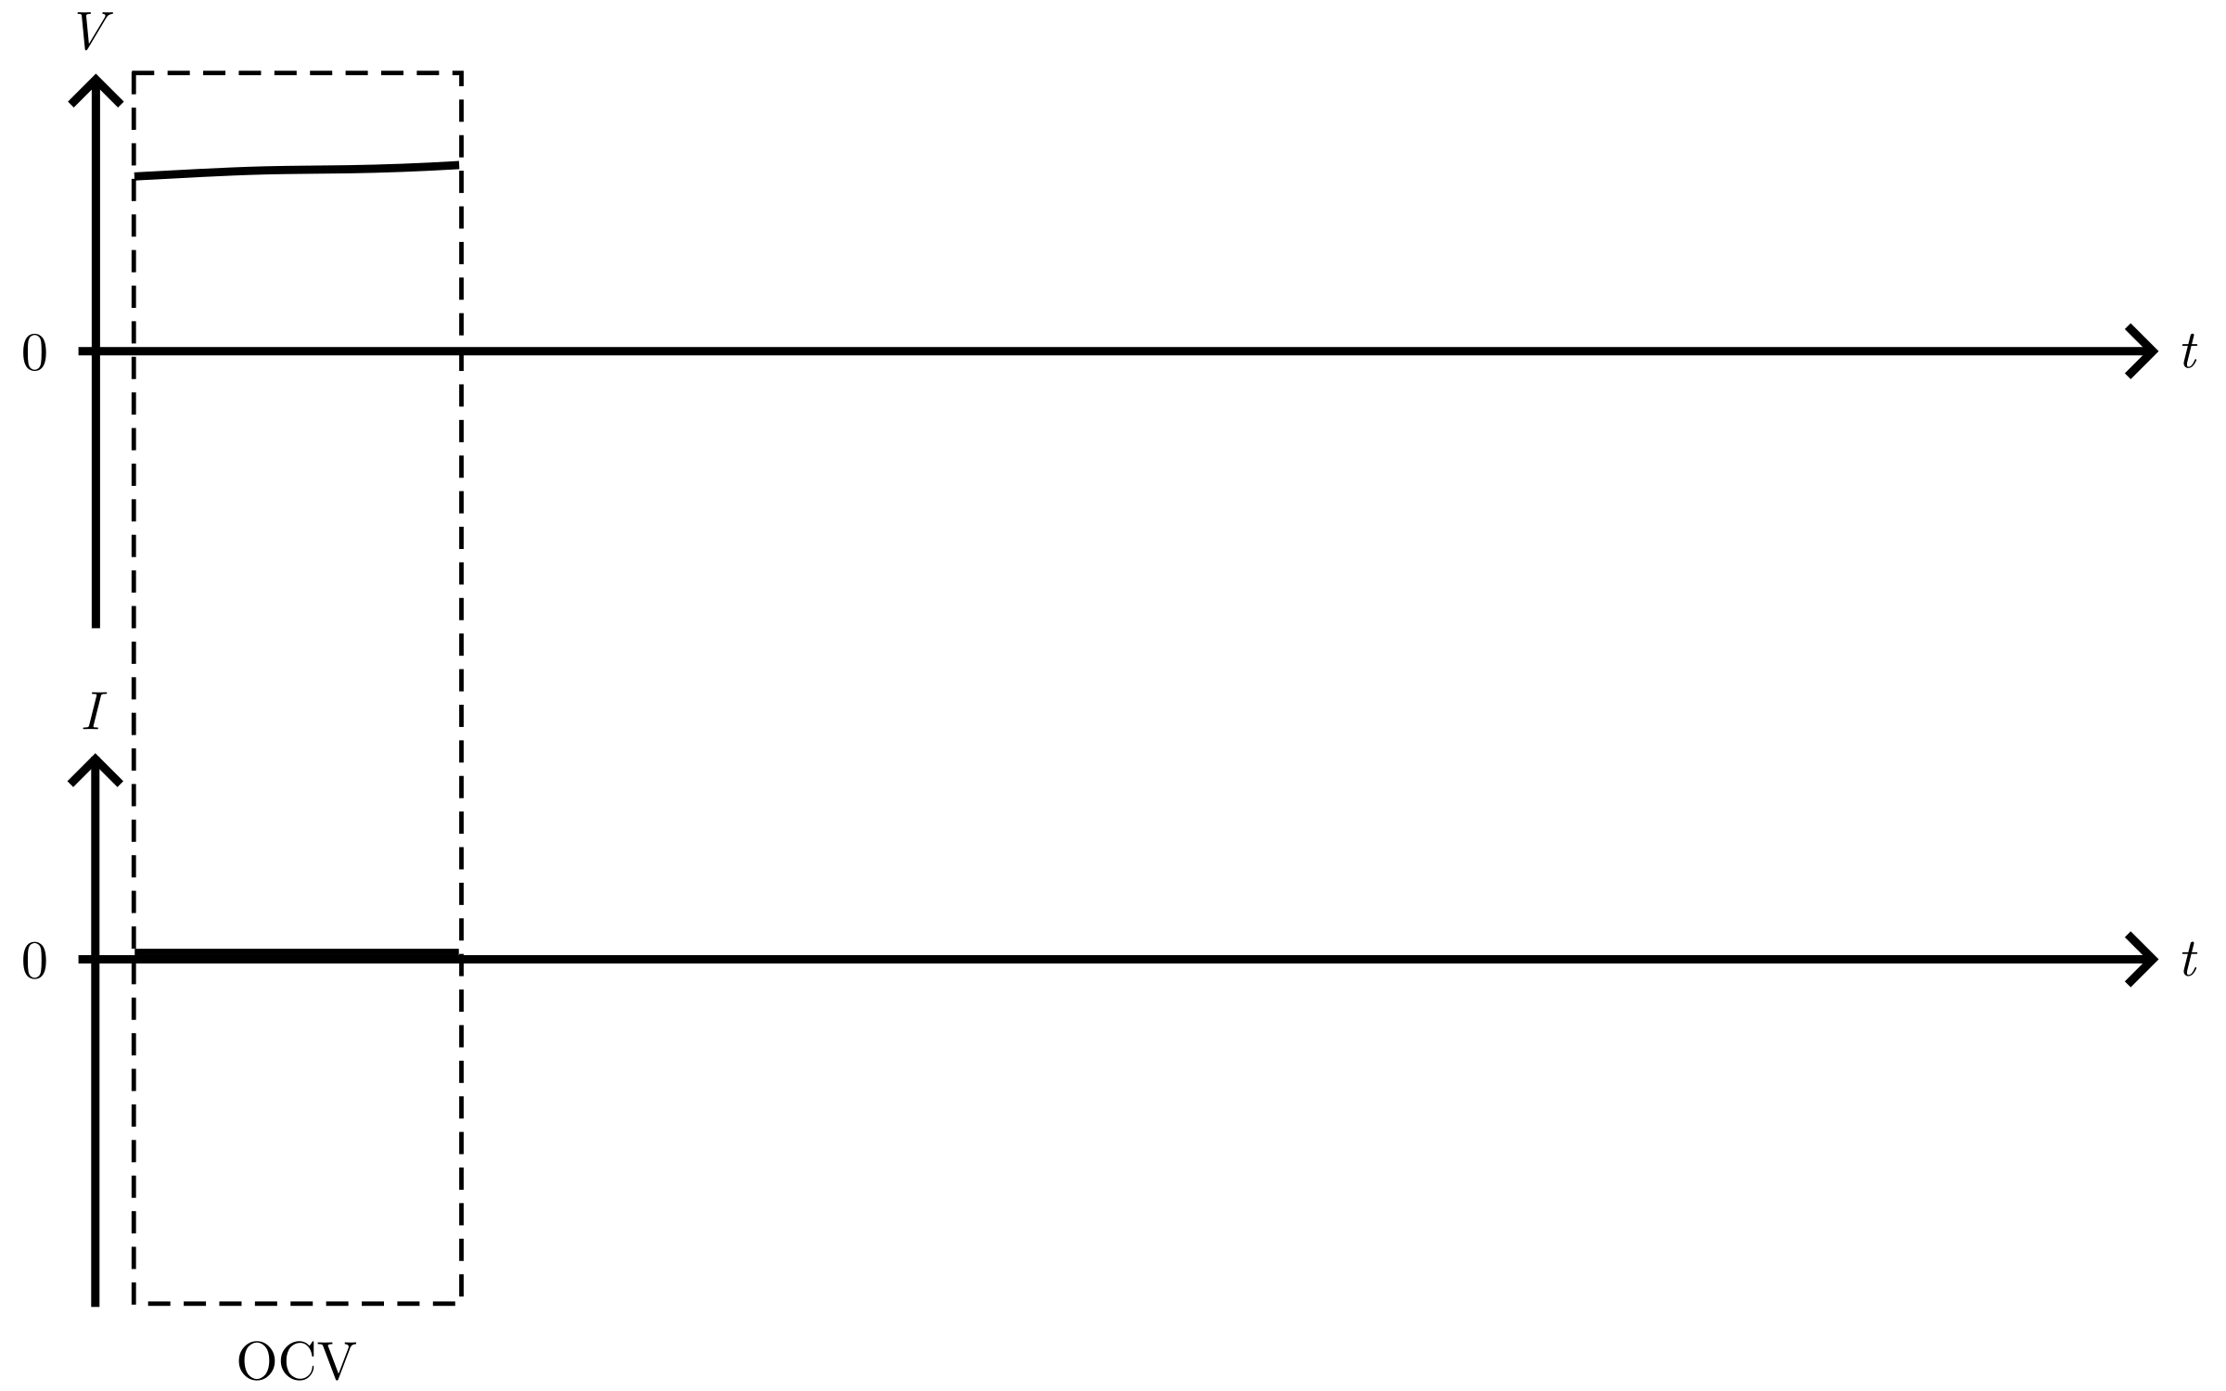
Deposition protocol

Slide 43
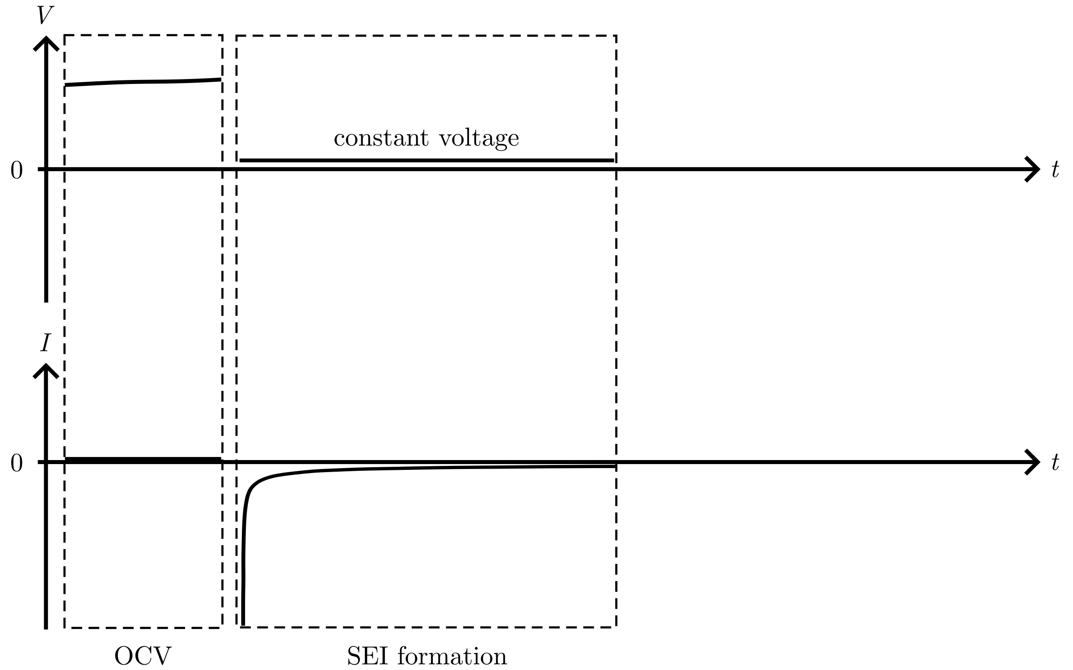
Deposition protocol

Slide 44
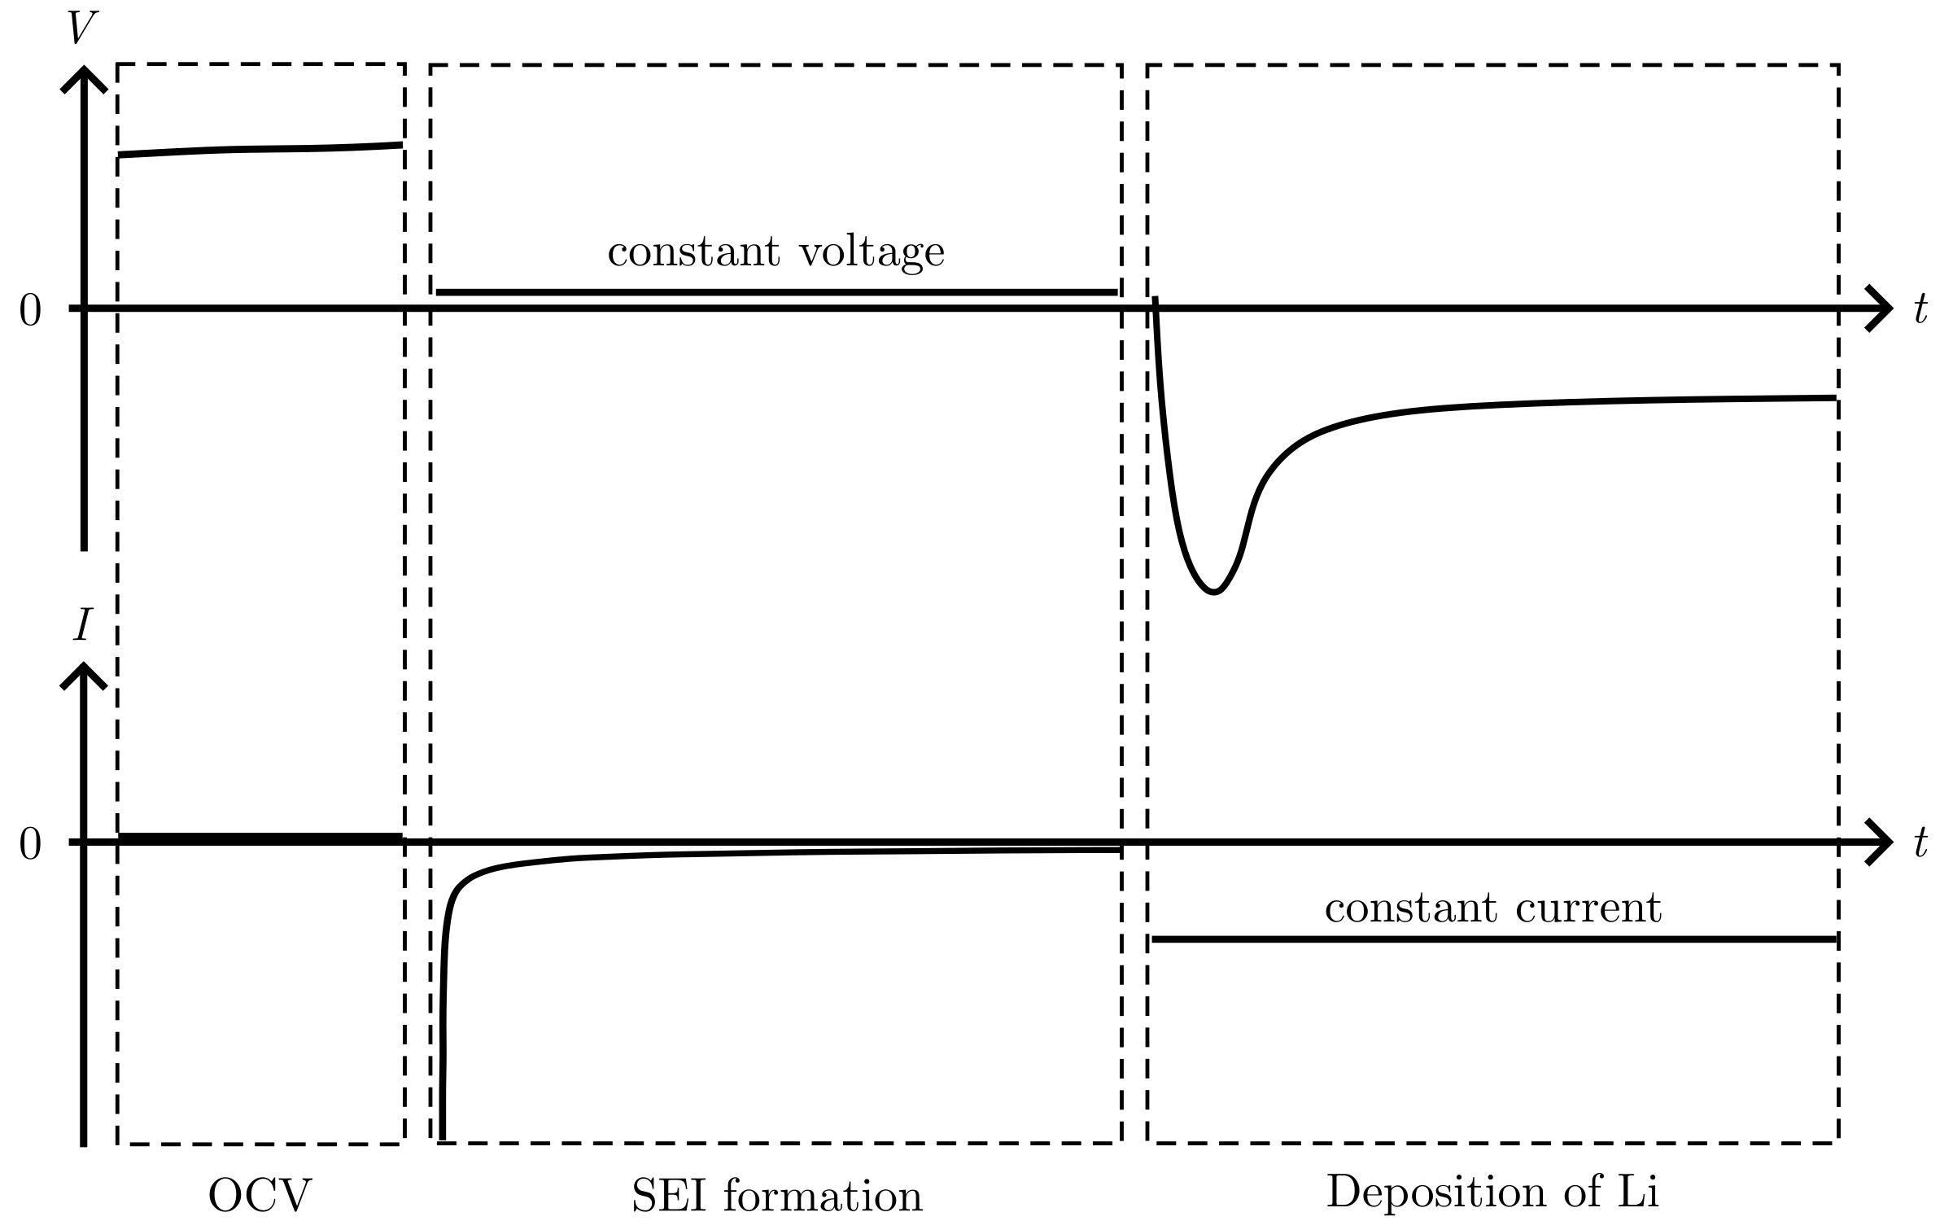
Deposition protocol

Slide 45
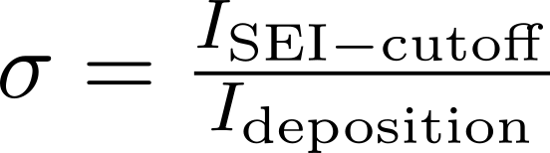

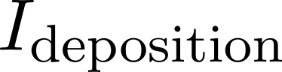
Deposition protocol:

Slide 46
Passivation of the Cu surface
Notes:
To investigate the passivation of the Cu surface before deposition, several T-cell were cycled

Slide 47
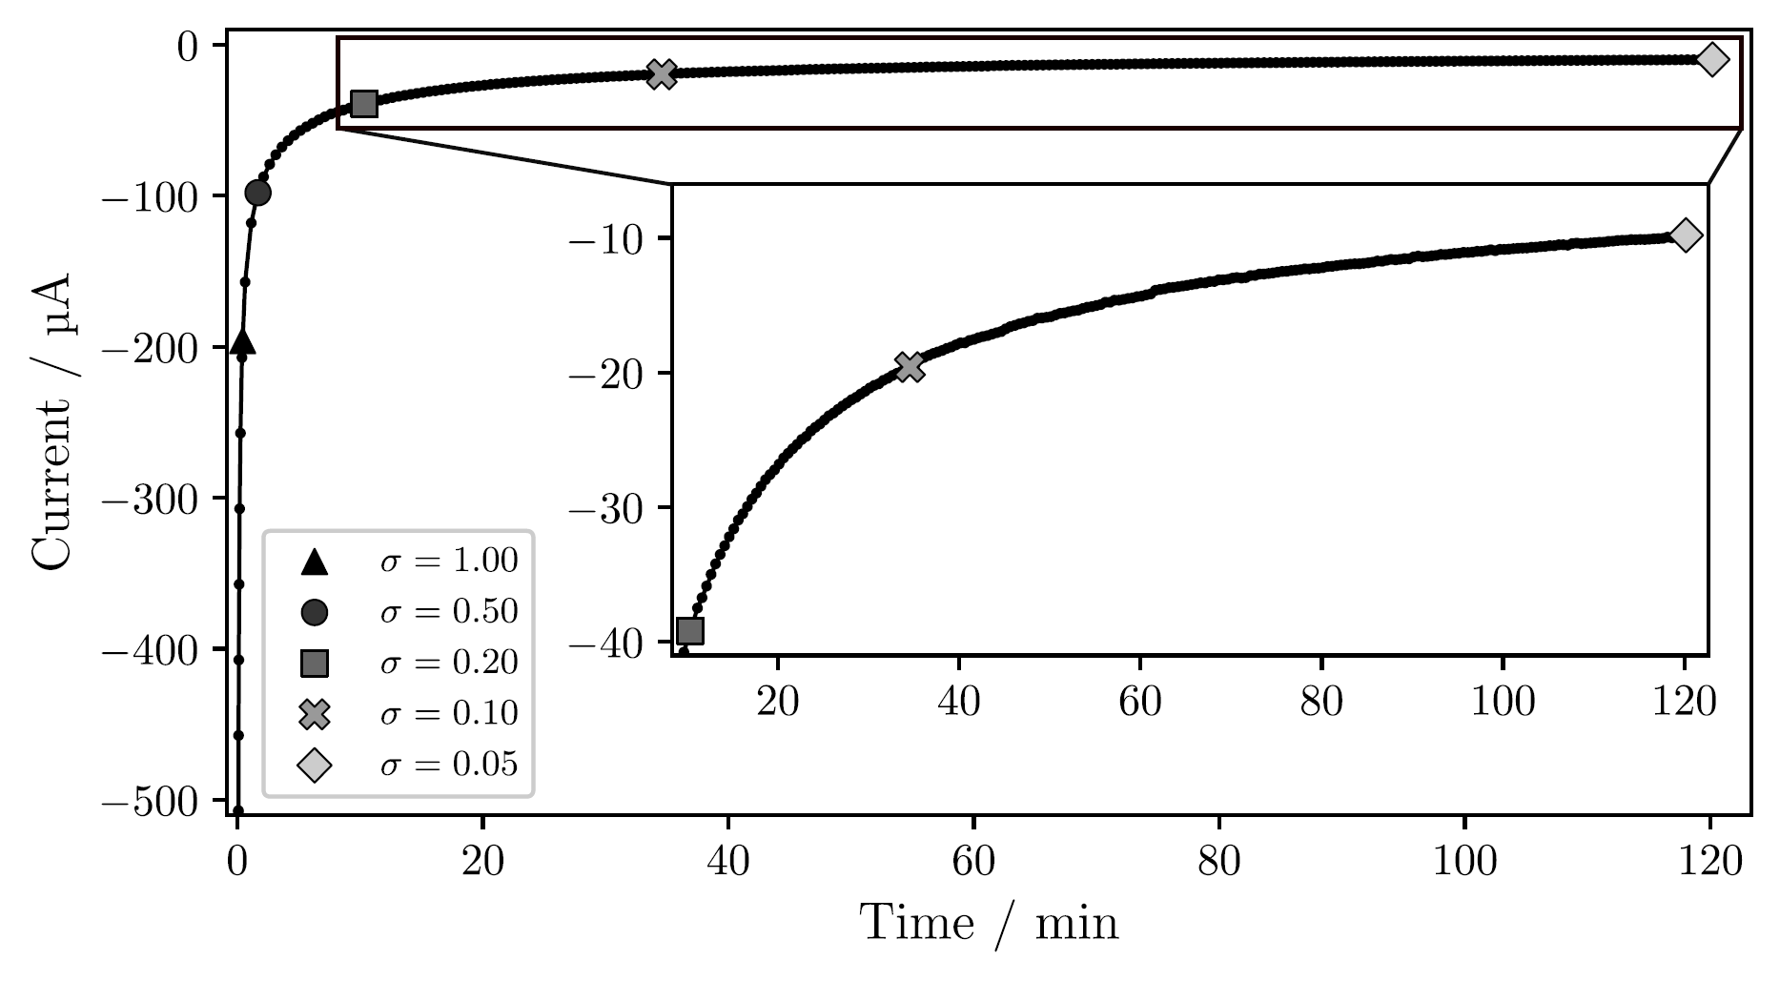
Passivation of the Cu surface
Notes:
First, the current versus time during the SEI formation by holding a constant low voltage.
T-cell, Jdeposition = 1 mAh/cm²
Time increase for lower sigma: 2 min for 0.50

Slide 48
Passivation of the Cu surface
Notes:
First, the current versus time during the SEI formation by holding a constant low voltage.
T-cell, Jdeposition = 1 mAh/cm²
Time increase for lower sigma: 2 min for 0.50, 2 hour for 0.05
After the passivation, Li was deposited at constant current

Slide 49
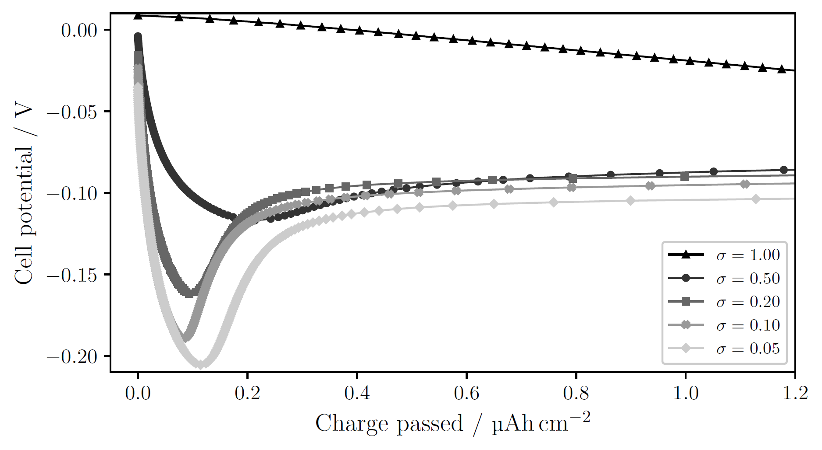
Passivation of the Cu surface
Notes:
T-cell, 1 mAh/cm²
sigma=1.00: no obvious nucleation; side reactions large enough to drive current without need for nucleation
Decreasing sigma → clearer deposition peak at higher overpotential

Slide 50
Passivation of the Cu surface
Notes:
T-cell, 1 mAh/cm²
Larger overpotential → smaller nuclei, larger N → many sites for continued growth, lowering the necessity for further nucleation. Other words: more instantaneous nucleation (all nuclei form at the start and then they only grow).
Opposed to progressive nucleation, where nuclei continue to form as other grow

Slide 51
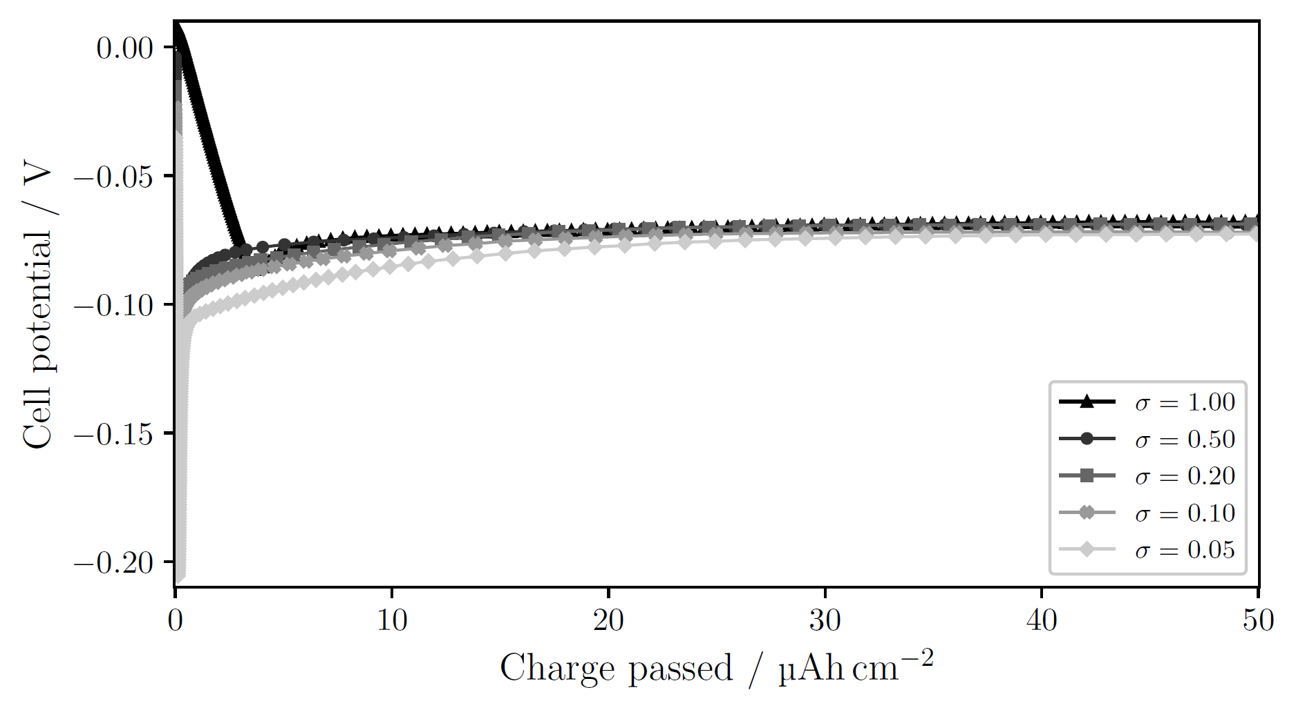
Passivation of the Cu surface larger charge passed
Notes:
T-cell, 1 mAh/cm²
sigma=1.00: no obvious nucleation; side reactions large enough to drive current without need for nucleation
Decreasing sigma → clearer deposition peak at higher overpotential
Larger overpotential → smaller nuclei, larger N → many sites for continued growth, lowering the necessity for further nucleation. Other words: more instantaneous nucleation (all nuclei form at the start and then they only grow).
Opposed to progressive nucleation, where nuclei continue to form as other grow

Slide 52
Deposition current
Notes:
Several C-cells were cycled to see the affects of the deposition current.

Slide 53
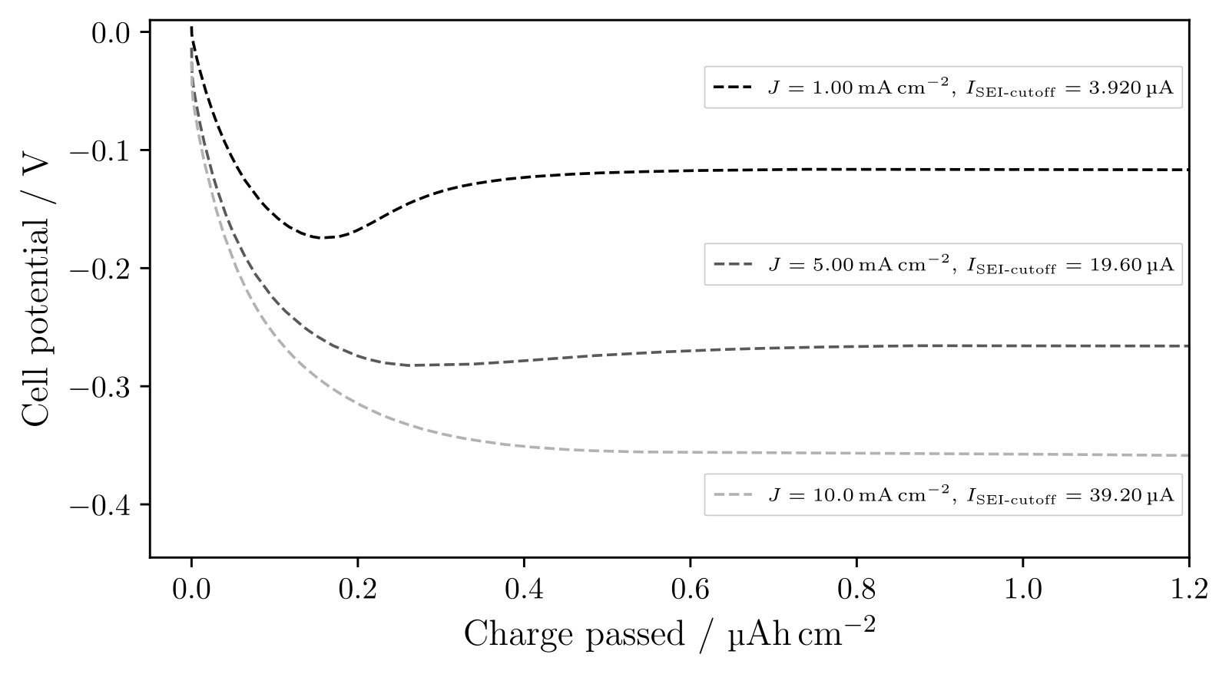
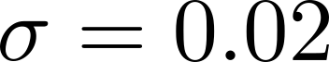
Deposition current
Notes:
Increasing current, J, results in a higher overpotential.
However, with the same sigma, the nucleation peak disappears for larger currents.
We just saw that the deposition peak is dependent on sigma, so what would happen if we passivated the surface more?

Slide 54
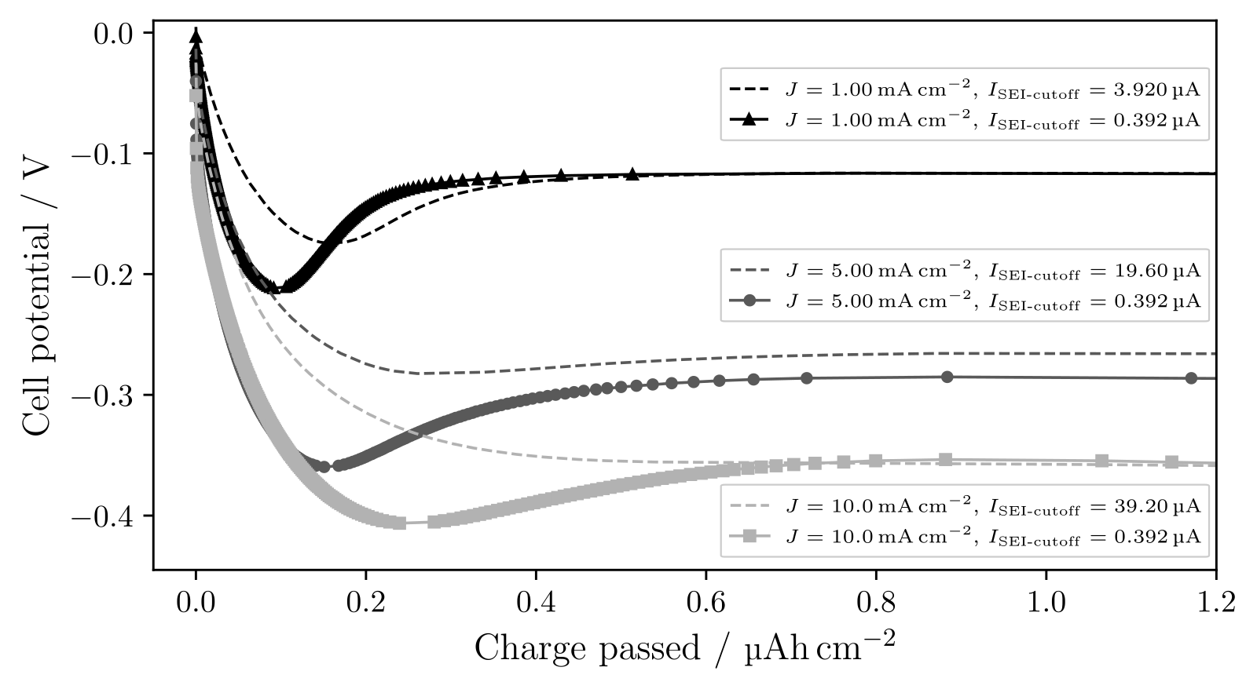
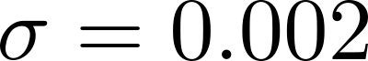
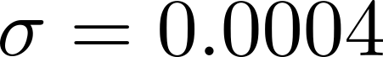
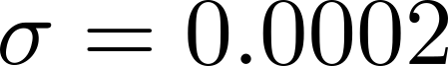
Deposition current with more passivation
Notes:
See, now the deposition peak becomes visible for larger currents.
As discussed, the sharper deposition peak indicates more instantaneous nucleation.
Thus, the absolute passivation seems to be important, I_SEI-cutoff, since we then do see the nucleation peak for all current

Slide 55
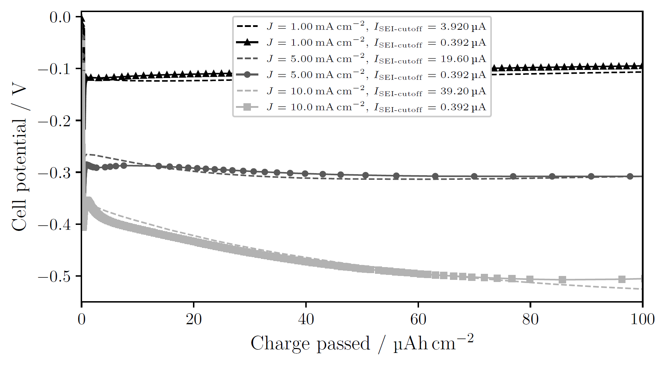
Deposition current with more passivation larger charge passed

Slide 56
Pressure effects
Notes:
To investigate the effect of pressure, a C-cell was cycled

Slide 57
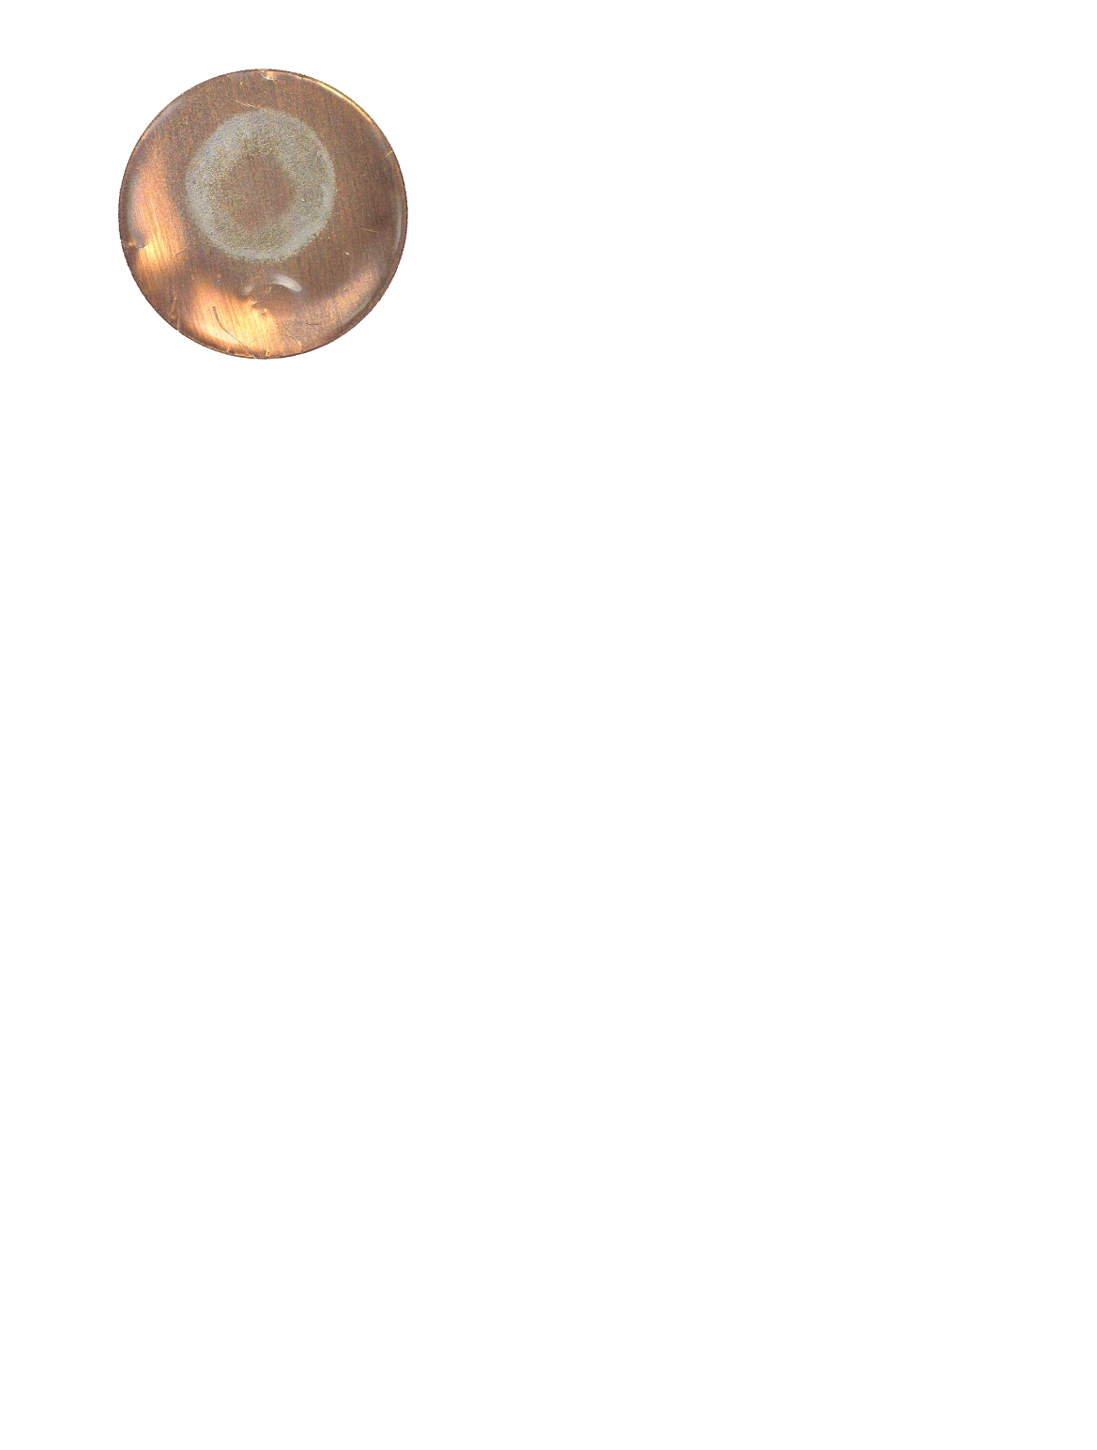
Pressure effects
Notes:
Photograph Li on Cu
* uneven deposition from the annulus: little to no Li in the middle, more for larger radii

Slide 58

Pressure effects
Notes:
SEM-images, overlain: matched the features on the images with each other

Slide 59

Pressure effects
Notes:
Zoom in: see small Lithium nuclei

Slide 60

Pressure effects
Notes:
Moving down, slightly larger nuclei

Slide 61

Pressure effects
Notes:
Here even larger nuclei
Thus, for various radial positions we see different morphologies of Li: from small crystalline particles to larger ‘’islands’’

Slide 62
Pressure effects
2r = 1 µm
2r = 2 µm to 3 µm
2r ≥ 4 µm
Notes:
The typical size (diameter) of the nuclei goes from 1 here, 2 to 3, and then larger than 4.

Slide 63
Pressure effects
2r = 1 µm
N = 0.024 nuclei/µm²
2r = 2 µm to 3 µm
N = 0.022 nuclei/µm²
2r ≥ 4 µm
N = 0.016 nuclei/µm²
Notes:
Nuclei per area decreases while the nuclei size increases

Slide 64
Pressure effects
2r = 1 µm
N = 0.024 nuclei/µm²
2r = 2 µm to 3 µm
N = 0.022 nuclei/µm²
2r ≥ 4 µm
N = 0.016 nuclei/µm²
Notes:
These relations should be familiar

Slide 65

Pressure effects
Notes:
So, the distribution changes radially. How about the along the edge of the deposition?

Slide 66

Pressure effects
Notes:
SEM images for different angles around the edge of the deposition

Slide 67

Pressure effects
Notes:
Zoom in: see some particles, and bush-like growth

Slide 68

Pressure effects
Notes:
Here it’s mostly round particles

Slide 69

Pressure effects
Notes:
Down here overwhelmingly bush-like growth.
Yes, the deposition changes also with the angle along the deposited annulus

Slide 70


Pressure effects
Wave spring
Notes:
The reason is probably the wave spring used in the C-cell.
A study found that the wave spring induces uneven pressure in the cell, with low pressure in the middle and higher pressure for larger radii.
Exactly as the annulus of deposited Li shows.
Photograph shows that the wave spring pushed down at some points, which could explain the angular variation

Slide 71
Pressure effects
Notes:
To verify that the pressure influences the deposition, a T-cell was cycled and measured in SEM

Slide 72

Pressure effects
Notes:
SEM images as before, over the same distance the Li distribution seems more or less the same – at least much more even than in the C-cell

Slide 73

Pressure effects
Notes:
Zoom in shows that the morphology is small crystalline particles, with longer and thinner needle-like growths.
While ‘’islands’’ are not observed in the T-cell, this needle-like growth might evolve into the bush-like growth we saw in the C-cell.

Slide 74
Conclusions
More instantaneous or more progressive nucleation depends on the current ratio of the side reactions and the deposition (σ).
The nuclei distribution (r and N) is influenced by the current and the degree of passivation (both changes the nucleation peak η).
Uniform pressure between the electrodes is essential to achieve uniform deposition.

Slide 75
Thank you for listening!

Slide 76
//Lägg in fler plots här efter på större charge och andra figurer som Isak kanske kommenterar

Slide 77
Electrochemical deposition of lithium on copper
Gottfrid Olsson
2024-05-29

